Slide 1
The Clinical Pharmacogenetics Implementation Consortium: Incorporating Pharmacogenetics into Clinical Practice and the EHR

Slide 2
Learning Objectives
After completing this activity, the learner should be able to…
Describe barriers to clinical implementation of pharmacogenetics.
Describe CPIC and the underlying assumptions of CPIC guidelines.
Explain the CPIC guideline development process.
Illustrate how CPIC guidelines can be used by clinicians to make specific prescribing decisions for patient care when genetic information is available.
Illustrate how CPIC guidelines can be used to aid the clinical implementation of pharmacogenomics into the electronic health record with clinical decision support.

Slide 3
Survey: Challenges to implementing pharmacogenetics in the clinic
What do you think is the most challenging aspect of the implementation of pharmacogenetics into the clinic?
Translation of genetic information into clinical action
Test cost, test reimbursement or other economic issues
Availability of high quality genotyping test (CLIA approved)
Electronic medical record use, such as the application of CDS
Clinician and patient resistance and/or ethical concerns
Clin Pharmacol Ther. 2011 Mar;89(3):464-7.

Slide 4
Survey: top 3 Challenges to implementing pharmacogenetics in the clinic
95% of respondents selected: “process required to translate genetic information into clinical actions”
Next 2 responses
Genotype test interpretation (e.g. using genotype information to impute phenotype)
Providing recommendations for selecting the drug/gene pairs to implement
Clin Pharmacol Ther. 2011 Mar;89(3):464-7.

Slide 5
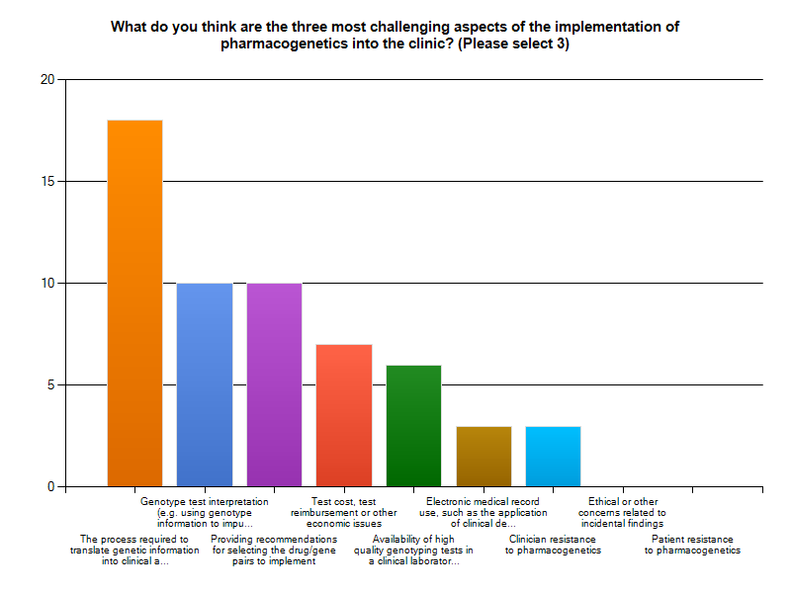
Clin Pharmacol Ther. 2011 Mar;89(3):464-7.

Slide 6
Key Points about a CPIC guideline
Based on assumption that the test results are in hand and NOT to discuss the merits of doing the test
Standardized formats
Grading of evidence and of recommendations
Peer reviewed
Freely available
Updated
Authorship with COI policy
Closely follow IOM practices

Slide 7
CPIC guidelines are designed to help clinicians understand HOW available genetic test results should be used to optimize drug therapy.
Not WHETHER tests should be ordered.
Key Assumption:
Clinical high-throughput and pre-emptive genotyping will become more widespread.
Clinicians will be faced with having patients’ genotypes available even if they did not order test with drug in mind.

Slide 8
Published 26 guidelines and 12 updates, covering 20 genes and > 65 drugs as of June 2021
2014
IL28B -- PEG interferon α
CFTR -- Ivacaftor
G6PD -- Rasburicase
CYP2C9, HLA-B -- Phenytoin
CYP2D6 – codeine--UPDATE
HLA-B – abacavir--UPDATE
SLCO1B1 – simvastatin—UPDATE
2015
CYP3A5 – tacrolimus
CYP2D6, CYP2C19– SSRIs
UGT1A1 – atazanavir
HLA-B – allopurinol—UPDATE
2016
CYP2C19 – voriconazole
CYP2D6 – ondansetron
CYP2C9, VKORC1 – warfarin--UPDATE
CYP2D6, CYP2C19 – TCAs--UPDATE
2017
CYP2D6 – tamoxifen
HLA-B – carbamazepine—UPDATE
DPYD -- 5FU / capecitabine—UPDATE-in review
2018
RYR1/CACNA1S– inhaled anesthetics
TPMT/NUDT15 – thiopurines—UPDATE
2019
CYP2B6—efavirenz
CYP2D6—atomoxetine
CYP2C9/NSAIDs
2020
CYP2C19/PPI
CYP2C9/HLA-phenytoin—UPDATE-
CYP2D6/OPRM1/COMT-opioids-UPDATE
2021
mtRNR1/aminoglycosides (published)
CYP2C19/clopidogrel-UPDATE
SLCO1B1/statins-UPDATE
G6PD/rasburicase-UPDATE (will include additional drugs)
CYP2D6-CYP2C19/SSRI-UPDATE
CYP2D6/ADRB1/ADRB2/GRK4/GRK5-Beta-blockers
CYP2B6/methadone
2011
TPMT – thiopurines
CYP2C19– clopidogrel
CYP2C9, VKORC1 – warfarin
2012
CYP2D6 – codeine
HLA-B – abacavir
SLCO1B1 – simvastatin
2013
HLA-B – allopurinol
CYP2D6, CYP2C19 – TCAs
HLA-B – carbamazepine
DPYD -- 5FU / capecitabine
TPMT – thiopurines—UPDATE
CYP2C19 – clopidogrel--UPDATE
https://cpicpgx.org/guidelines/
Notes:
Kelly to update this slide closer to the meeting

Slide 9
26 guidelines; 22 genes and > 65 drugs
TPMT, NUDT15
MP, TG, azathioprine
CYP2D6
Codeine, tramadol, hydrocodone, TCAs, tamoxifen, SSRIs, ondansetron, tropisetron, atomoxetine, beta-blockers (in progress)
CYP2C19
TCAs, clopidogrel, voriconazole, SSRIs, PPIs
VKORC1
Warfarin
CYP2C9
Warfarin, phenytoin, NSAIDs
CYP4F2
Warfarin
HLA-B
Allopurinol, CBZ, Oxcarbazepine, abacavir, phenytoin
HLA-A
CBZ
CFTR
Ivacaftor
DPYD
5FU, capecitabine, tegafur
G6PD
Rasburicase
UGT1A1
Atazanavir
SLCO1B1
Simvastatin
IFNL3 (IL28B)
Interferon
CYP3A5
Tacrolimus
CYP2B6
Efavirenz, methadone (in progress)
RYR1, CACNA1S
Inhaled anesthetics
MT-RNR1
Aminoglycosides
OPRM1
Opioids (CPIC level C-no recommendation)
COMT
Opioids (CPIC level C-no recommendation)
https://cpicpgx.org/guidelines/

Slide 10
As of June 2021:
>400 Members
Clinicians and scientists
> 260 institutions
35 countries
14 Observers (NIH, FDA, professional societies)
CPIC Informatics
>35 members from 25 organizations
Notes:
89 in 2013
42 institutions

Slide 11
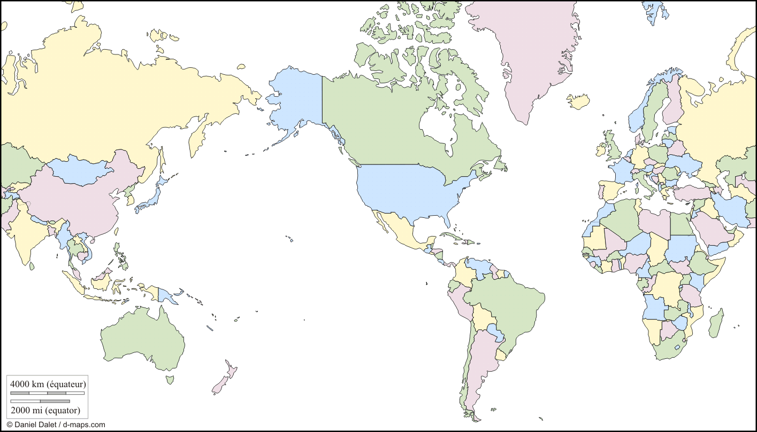
>400 members
Academic, Hospital,
Health Care Systems
Industry

Slide 12
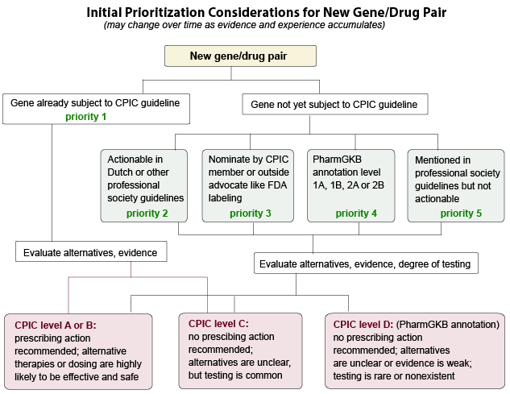
Initial Prioritization Considerations for New Gene/Drug Groups
New genes/drugs

Slide 13
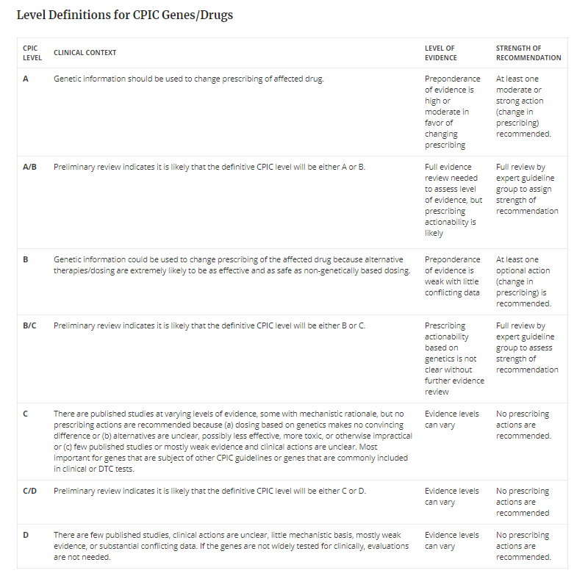
https://cpicpgx.org/prioritization/#flowchart

Slide 14
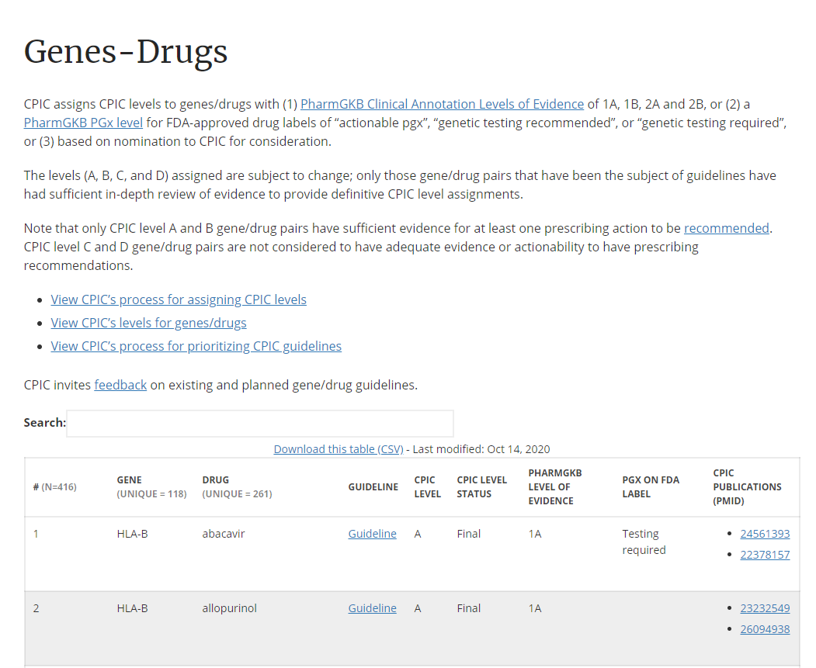
https://cpicpgx.org/genes-drugs/

Slide 15
Clin Pharmacol Ther. 2013 Feb;93(2):153-8
Clin Pharmacol Ther. 2013 Apr;93(4):324-5.
Clin Pharmacol Ther. 2013 May;93(5):402-8.
Clin Pharmacol Ther. 2013 Sep;94(3):317-23
Clin Pharmacol Ther. 2013 Sep;94(3):324-8.
Clin Pharmacol Ther. 2013 Aug 29. Epub
Clin Pharmacol Ther. 2014 Feb;95(2):141-6.

Slide 16
www.cpicpgx.org

Slide 17
https://cpicpgx.org/guidelines/
Links to guideline pages

Slide 19
CPIC slides
CPIC projects
CPIC SOPs

Slide 20
https://cpicpgx.org/implementation/

Slide 21
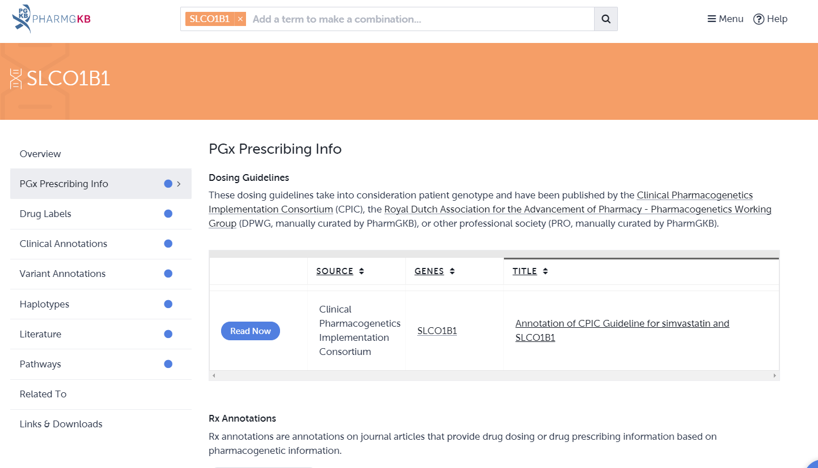
https://www.pharmgkb.org/
CPIC guidelines are posted on PharmGKB (www.pharmgkb.org)

Slide 22
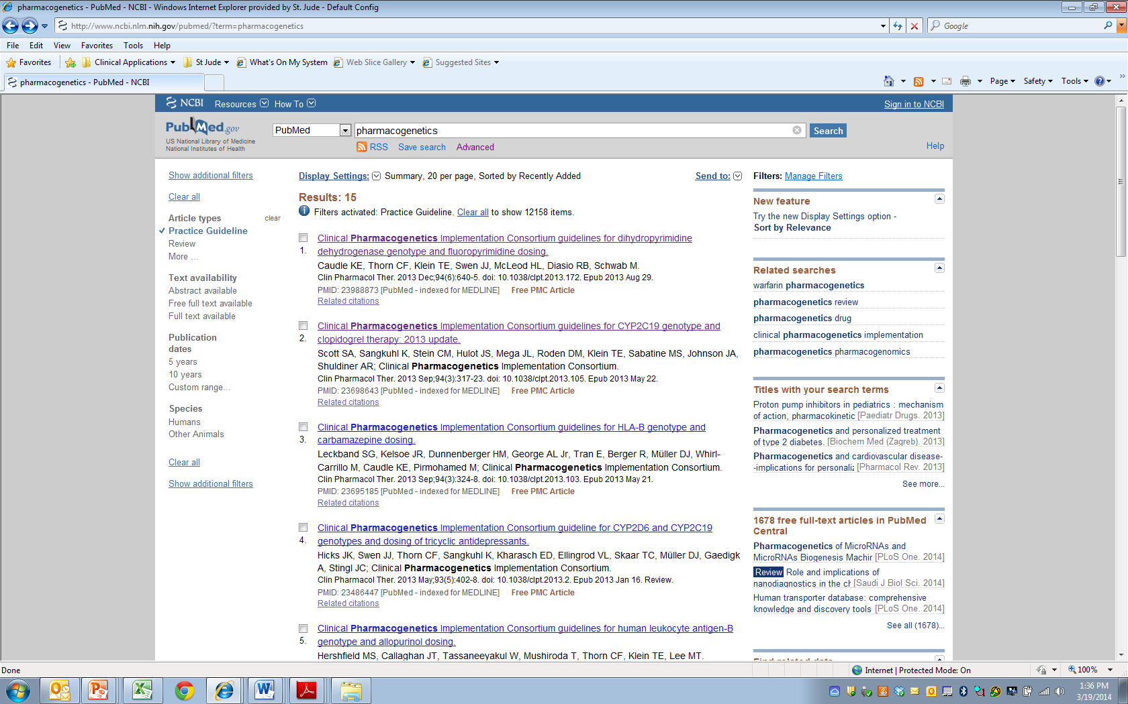
CPIC guidelines linked to “Practice Guideline” filter on PubMed

Slide 23
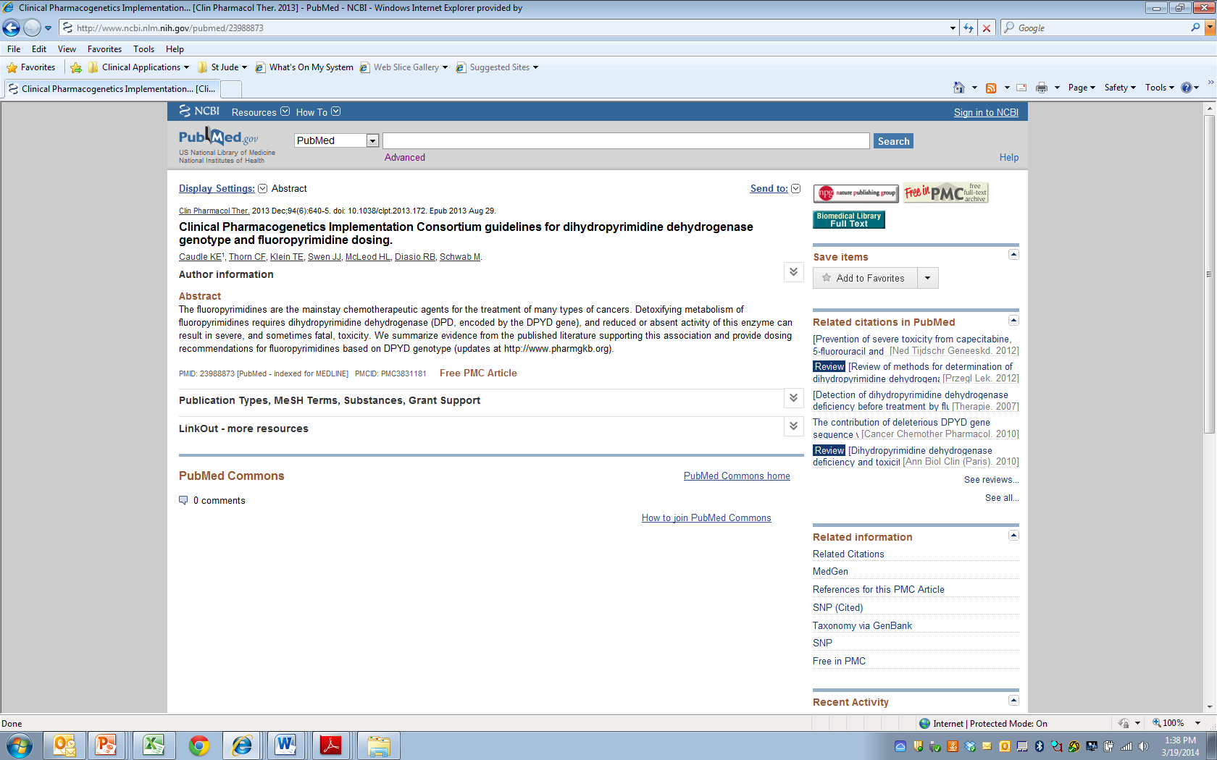

Slide 24
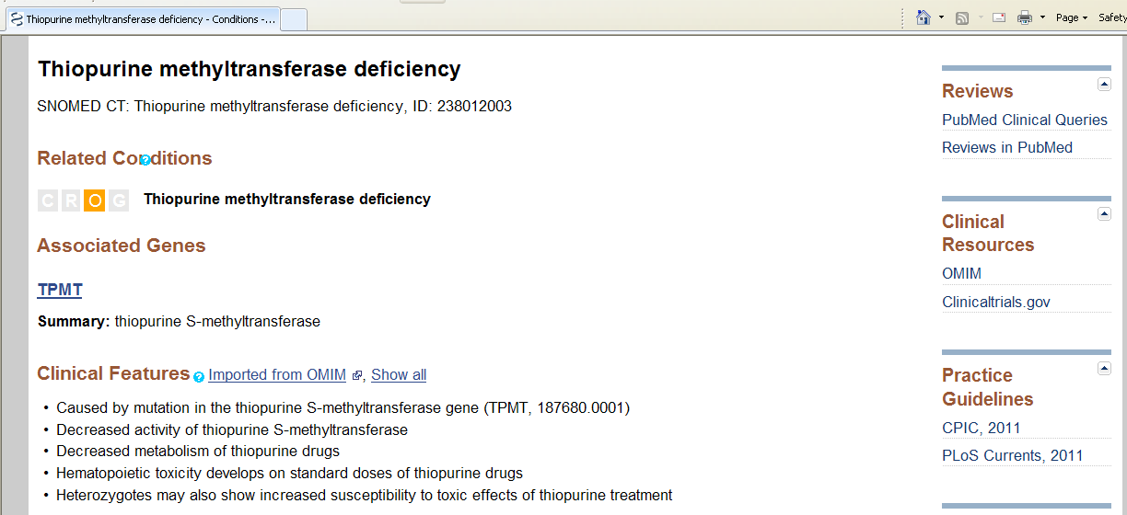
CPIC is cited in NIH’s Genetic Test Registry (GTR) for clinical pharmacogenetic tests

Slide 25
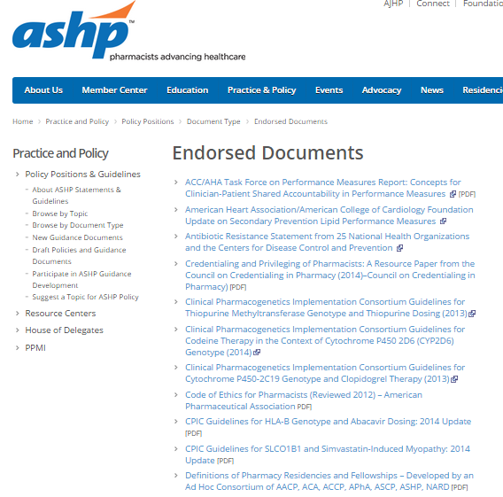
ASHP and ASCPT endorse CPIC guidelines

Slide 26
External interactions with other groups
Endorsement by professional societies
ASCPT, ASHP
Continue interactions with PharmGKB, PharmVar, ClinGen/ClinVar, NIH’s GTR, PubMed, FDA, NHGRI’s Genomic Medicine Working Group, IOM’s Genomic Medicine Roundtable, DIGITiZE, PGRN, AMIA, and eMERGE

Slide 28
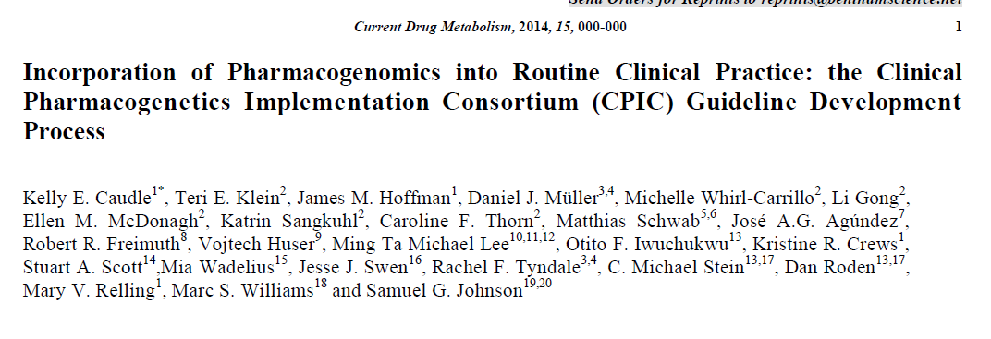
Purpose:
To describe the development process of the CPIC guidelines
To compare our process to the Institute of Medicine’s Standards for Developing Trustworthy Clinical Practice Guidelines

Slide 29
Caudle et al, Current Drug Metab 2014

Slide 30
Uniform Elements of CPIC Guidelines (Main)
Introduction
Focused Literature Review
Gene:
Background
Genetic Test Interpretation
Table 1. Assignment of likely _____ [gene] phenotypes based on genotypes
Available Genetic Test Options
Incidental findings
Other considerations

Slide 31
Uniform Elements of CPIC Guidelines (Main)
Drug (s):
Background
linking genetic variability to variability in drug-related phenotypes
Dosage Recommendations
Table 2. Recommended Dosing of ____ [drug/s] by ____ [gene] phenotype
Strength of recommendations grading system
Recommendations for Incidental Findings
Other considerations
Potential Benefits and Risks for the Patient
Caveats: Appropriate Use and/or Potential Misuse of Genetic Tests

Slide 32
Uniform Elements of CPIC Guidelines (Supplement and online resources)
Literature Review details
Genetic Test Interpretation
Available Genetic Test Options
Supplemental Table . Evidence linking genotype with phenotype
Levels of Evidence grading system
Allele Definition Table
Allele Functionality Table
Frequency Table
Resources to facilitate incorporation of pharmacogenetics into an electronic health record with clinical decision support (CDS) (workflow diagrams and example CDS alerts and consults)

Slide 33
Clin Pharmacol Ther. 2017 Jul;102(1):45-51.

Slide 34
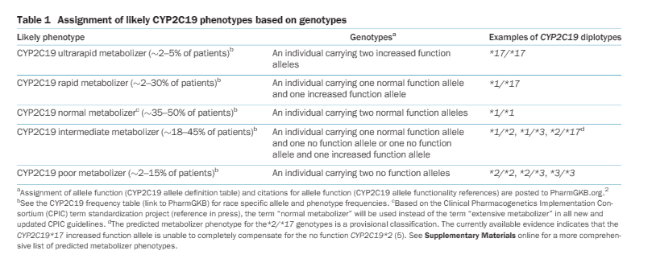

Slide 35
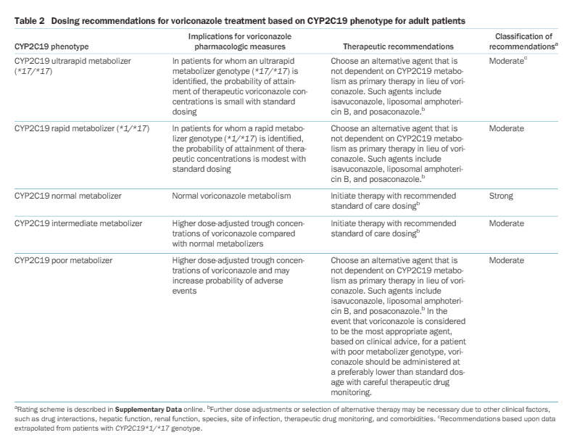

Slide 37
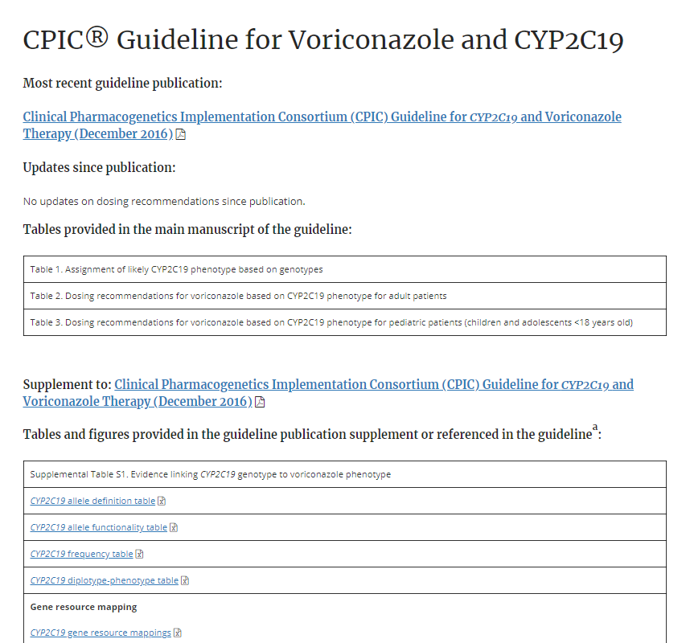
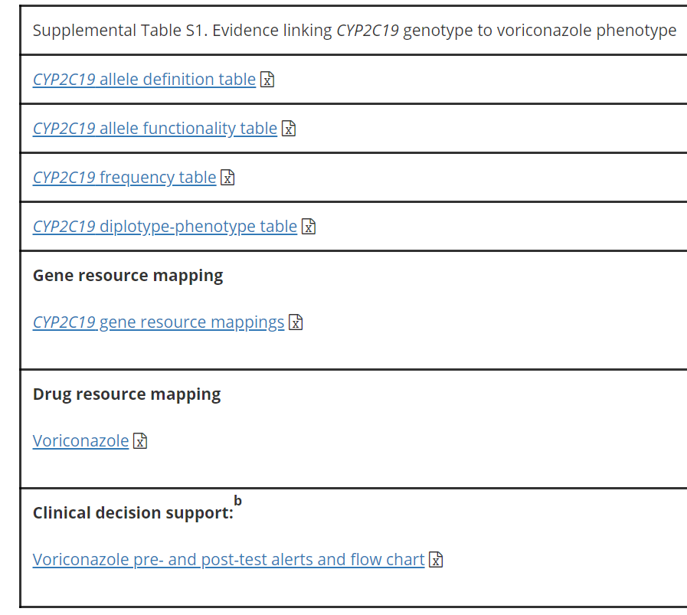

Slide 38
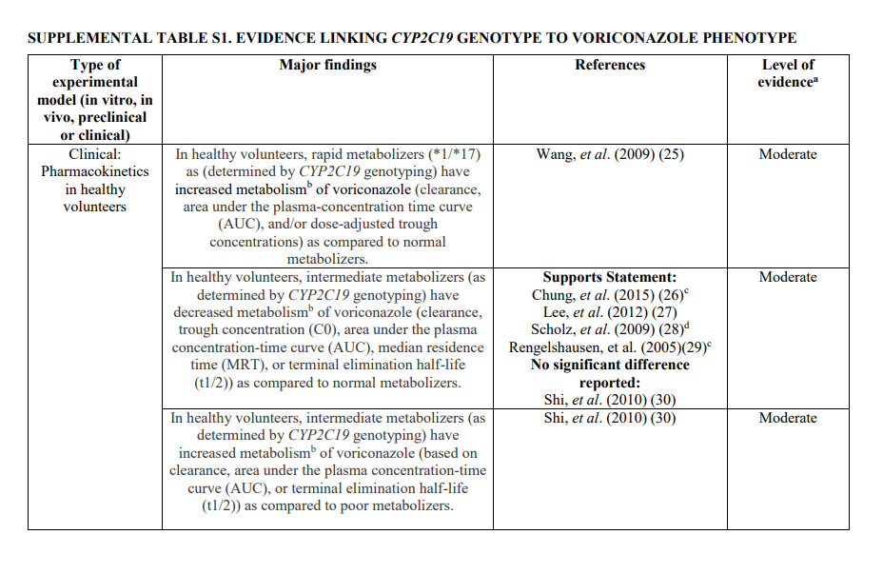
High: Evidence includes consistent results from well-designed, well-conducted studies.
Moderate: Evidence is sufficient to determine effects, but the strength of the evidence is limited by the number, quality, or consistency of the individual studies; generalizability to routine practice; or indirect nature of the evidence.
Weak: Evidence is insufficient to assess the effects on health outcomes because of limited number or power of studies, important flaws in their design or conduct, gaps in the chain of evidence, or lack of information

Slide 39
Clin Pharmacol Ther. 2014 Apr;95(4):376-82

Slide 40
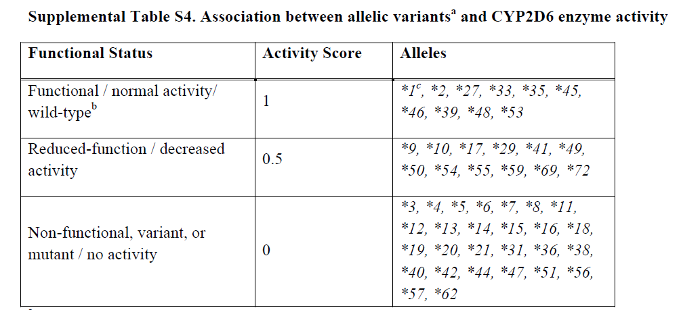
Normal
Clin Pharmacol Ther. 2014 Apr;95(4):376-82

Slide 41
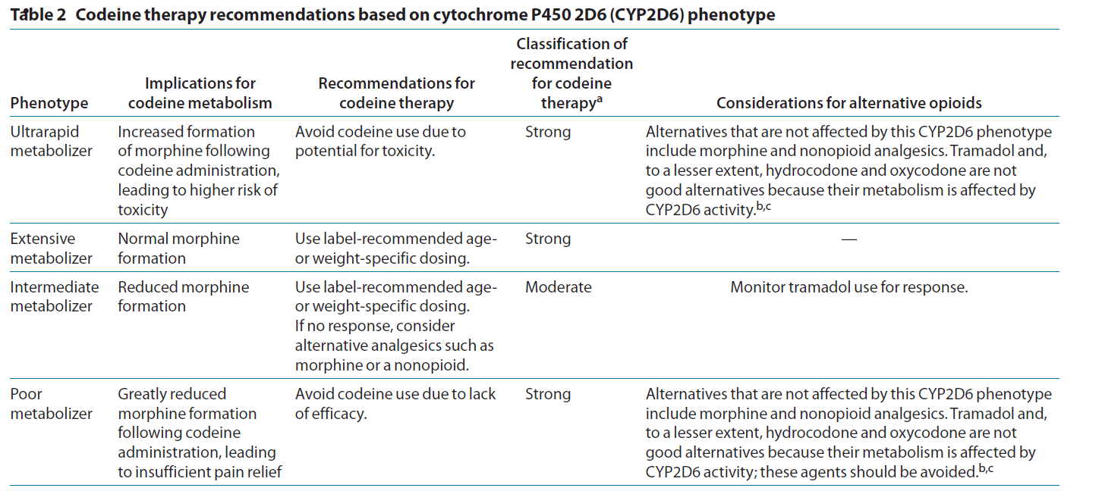
Normal

Slide 42
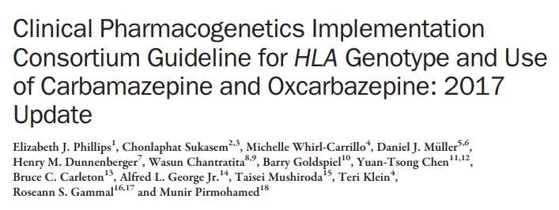
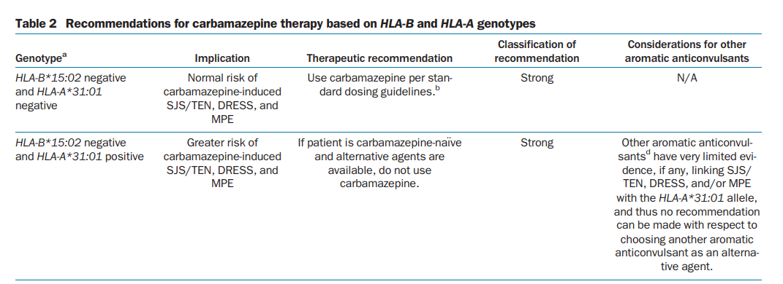
Clin Pharmacol Ther. 2012 Apr;91(4):734-8.

Slide 43
CPIC Guidelines Updates
CPIC guidelines are evaluated on an ongoing basis and updated regularly
Update to publications:
New publication with re-publishing main dosing tables
Changes as needed to supplemental material and website.
Update to cpicpgx.org: as needed, without waiting for updated publication

Slide 44
How can CPIC accelerate the clinical implementation of pharmacogenetics into EHRs with CDS?
Publish and maintain authoritative translation tables
Genotype/Diplotype
Phenotype
Recommendation

Slide 45
CPIC Informatics Working Group
Growing interest in informatics aspects of CPIC guidelines and clinical implementation of pharmacogenetics
Working group is a forum for discussion and collaboration focused on informatics issues
Goal
To support the adoption of the CPIC guidelines by identifying, and resolving where possible, potential technical barriers to the implementation of the guidelines within a clinical electronic environment.

Slide 46
CPIC Informatics Working Group: Initial Focus
Create comprehensive translation tables from genotype to phenotype to clinical recommendation for CPIC guidelines
Define structure and process to efficiently develop and maintain in the most useful format(s)
Publish as part of CPIC guidelines and post on PharmGKB
Genotype/Diplotype
Phenotype
Recommendation

Slide 47
CPIC tables allow translation of genetic test results to actionability
Genotypes to alleles
(e.g. g.94761900C>T + g.94762706A>G = CYP2C19*4B)
Alleles to diplotypes
(e.g. g.94761900CT + g.94762706AG = CYP2C19*1/*4B)
Diplotypes to phenotypes
(e.g. CYP2C19*1/*4B = intermediate metabolizer)
Phenotypes to actionability
(e.g. intermediate metabolizer + Rx for amitriptyline = interruptive alert)
Functions to alleles
(e.g. CYP2C19*4B = no function)
Interpretation of phenotypes
(e.g. CYP2C19 intermediate metabolizer = altered dosing recommendations for TCAs but not clopidogrel)
https://cpicpgx.org/guidelines/
https://www.pharmgkb.org/page/cyp2c19RefMaterials

Slide 48
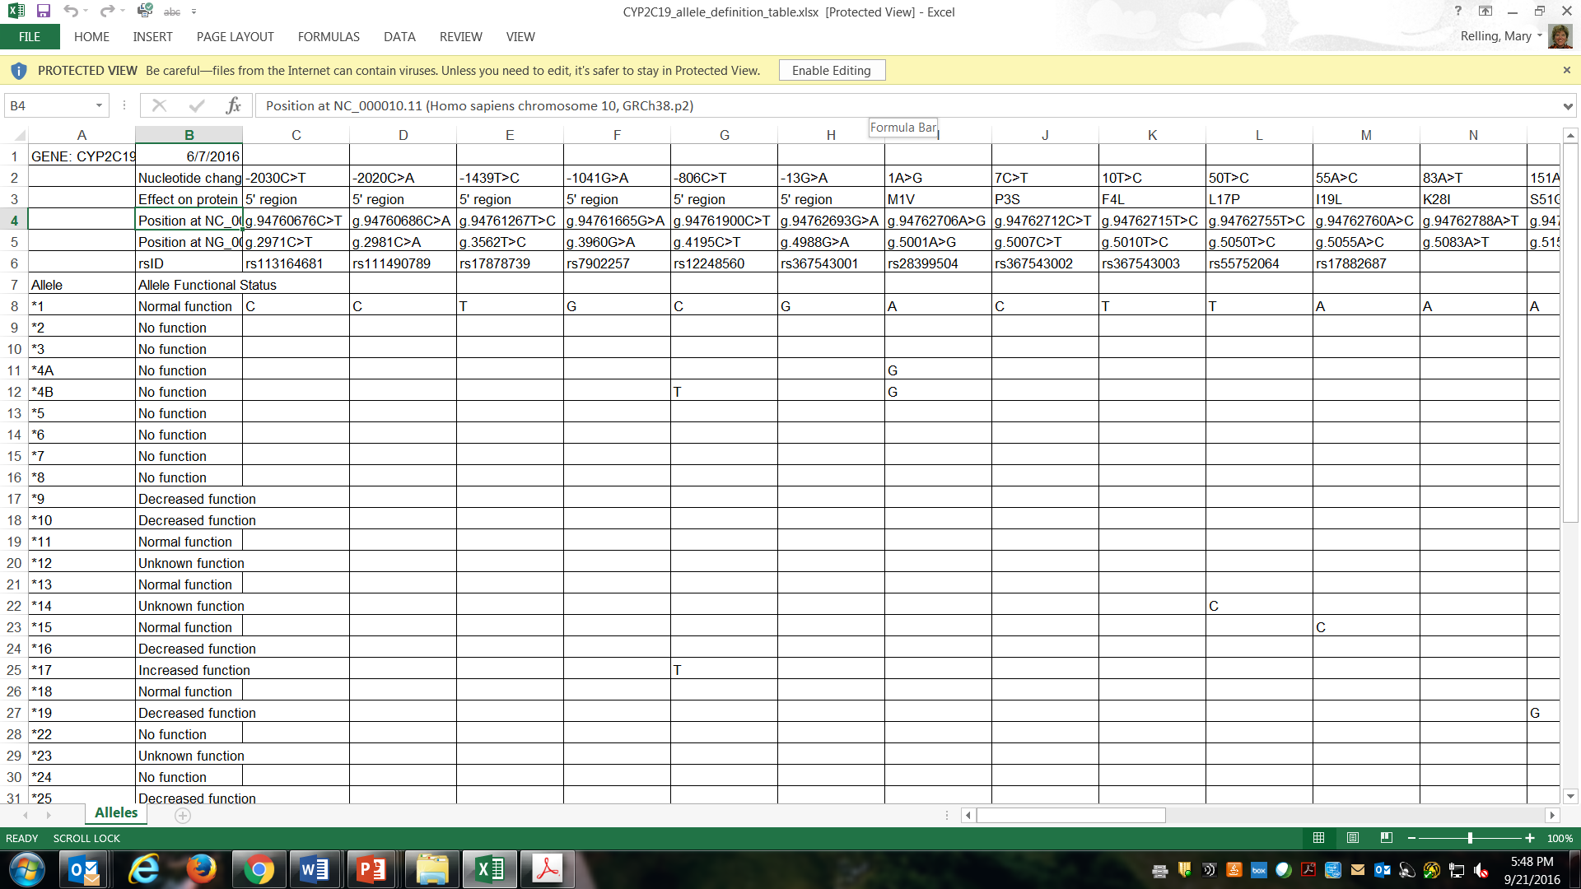
Allele definition table: genotypes to alleles
https://www.pharmgkb.org/page/pgxGeneRef
https://cpicpgx.org/guidelines/guideline-for-voriconazole-and-cyp2c19/

Slide 49
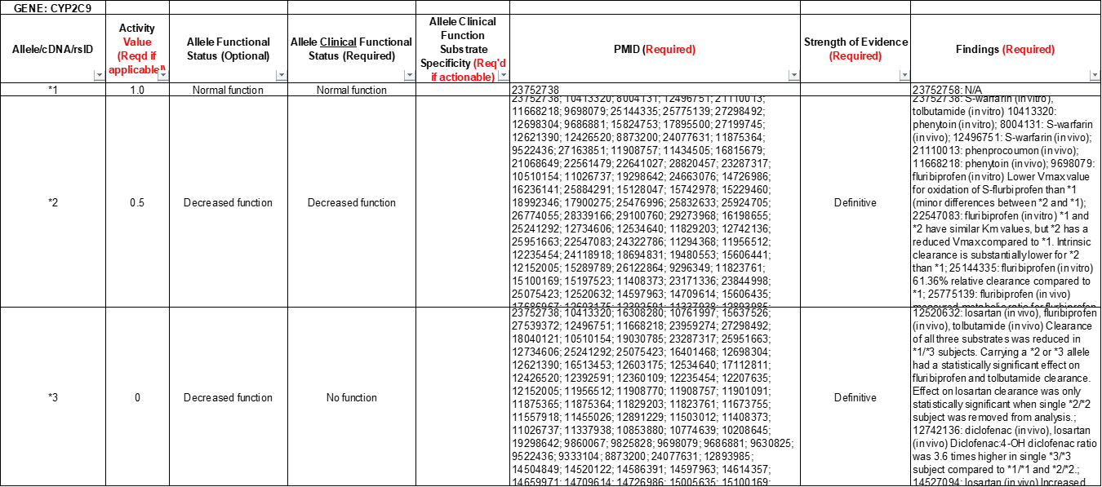
Allele functionality table: alleles to function
https://cpicpgx.org/guidelines/cpic-guideline-for-nsaids-based-on-cyp2c9-genotype/

Slide 50
CPIC tables allow translation of genetic test results to actionability
Genotypes to alleles
(e.g. g.94761900C>T + g.94762706A>G = CYP2C19*4B)
Alleles to diplotypes
(e.g. g.94761900CT + g.94762706AG = CYP2C19*1/*4B)
Diplotypes to phenotypes
(e.g. CYP2C19*1/*4B = intermediate metabolizer)
Phenotypes to actionability
(e.g. intermediate metabolizer + Rx for amitriptyline = interruptive alert)
Functions to alleles
(e.g. CYP2C19*4B = no function)
Interpretation of phenotypes
(e.g. CYP2C19 intermediate metabolizer = altered dosing recommendations for TCAs but not clopidogrel)
https://cpicpgx.org/guidelines/
https://www.pharmgkb.org/page/cyp2c19RefMaterials

Slide 51
Variants must be phased to assign diplotypes for pharmacogenes
CPIC Gene | Var/var different than var/wt?
TPMT | Yes
CYP2C19 | Yes
CYP2D6 | Yes
DPYD | Yes
CYP2C9 | Yes
SLCO1B1 | Yes
HLA-B | No
VKORC1 | Yes
IL28-B | Yes
CFTR | No
G6PD | Yes
UGT1A1 | Yes
CYP3A5 | Yes

Slide 52
CPIC tables allow translation of genetic test results to actionability
Genotypes to alleles
(e.g. g.94761900C>T + g.94762706A>G = CYP2C19*4B)
Alleles to diplotypes
(e.g. g.94761900CT + g.94762706AG = CYP2C19*1/*4B)
Diplotypes to phenotypes
(e.g. CYP2C19*1/*4B = intermediate metabolizer)
Phenotypes to actionability
(e.g. intermediate metabolizer + Rx for amitriptyline = interruptive alert)
Functions to alleles
(e.g. CYP2C19*4B = no function)
Interpretation of phenotypes
(e.g. CYP2C19 intermediate metabolizer = altered dosing recommendations for TCAs but not clopidogrel)
https://cpicpgx.org/guidelines/
https://www.pharmgkb.org/page/cyp2c19RefMaterials

Slide 53
Genotype to phenotype assignment based on allele function
Clin Pharmacol Ther. 2017 Jul: 102 (1):45-51.
https://cpicpgx.org/guidelines/guideline-for-voriconazole-and-cyp2c19/

Slide 55
https://www.pharmgkb.org/page/cyp2c19RefMaterials
https://cpicpgx.org/guidelines/guideline-for-voriconazole-and-cyp2c19/

Slide 56
CPIC tables allow translation of genetic test results to actionability
Genotypes to alleles
(e.g. g.94761900C>T + g.94762706A>G = CYP2C19*4B)
Alleles to diplotypes
(e.g. g.94761900CT + g.94762706AG = CYP2C19*1/*4B)
Diplotypes to phenotypes
(e.g. CYP2C19*1/*4B = intermediate metabolizer)
Phenotypes to actionability
(e.g. intermediate metabolizer + Rx for amitriptyline = interruptive alert)
Functions to alleles
(e.g. CYP2C19*4B = no function)
Interpretation of phenotypes
(e.g. CYP2C19 intermediate metabolizer = altered dosing recommendations for TCAs but not clopidogrel)
https://cpicpgx.org/guidelines/
https://www.pharmgkb.org/page/cyp2c19RefMaterials

Slide 57
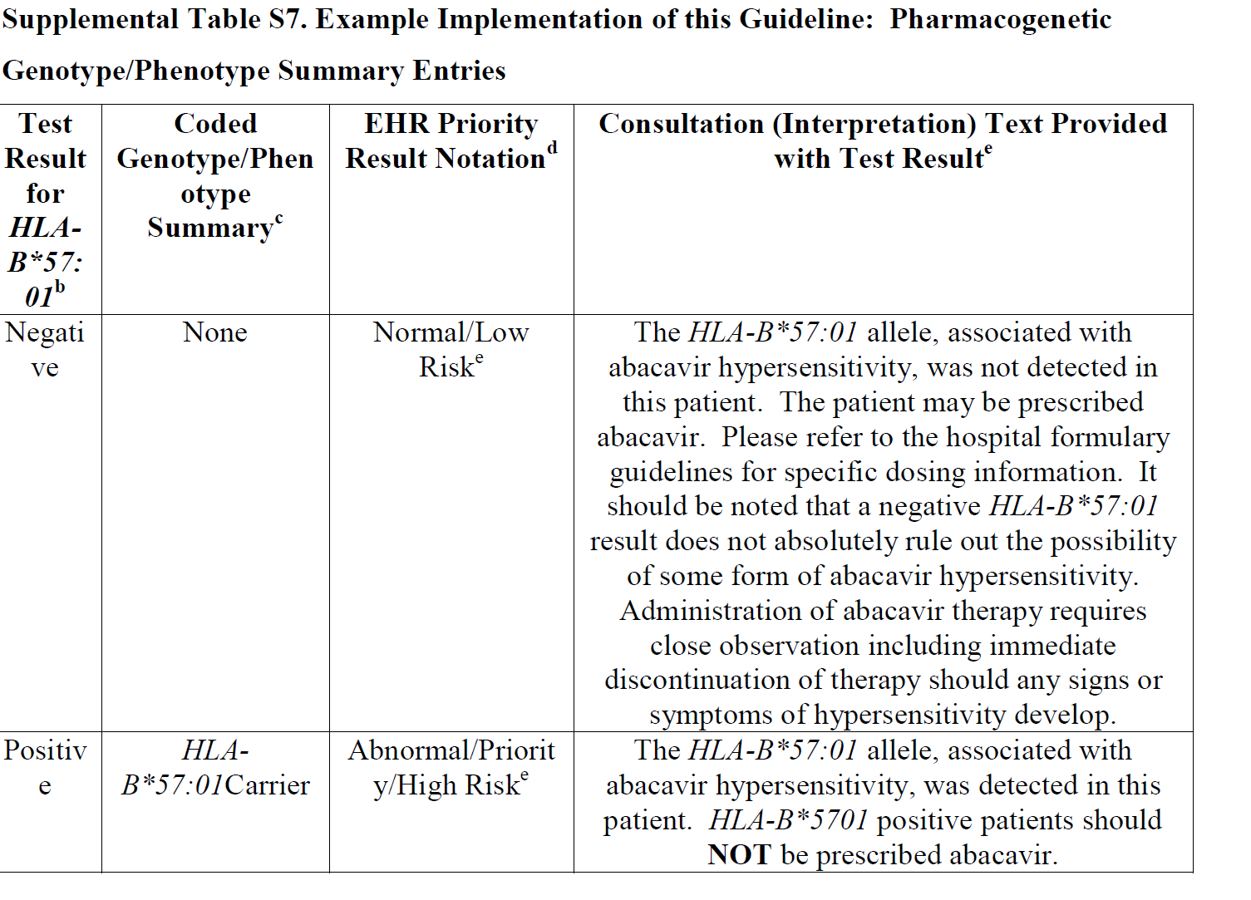
HLA-B*57:01 Pharmacogenetic Test Result: Clinical Implementation Workflow for EHR
Notes:
Supplemental Figure S3. HLA-B*57:01 Pharmacogenetic Test Result: Clinical Implementation Workflow for EHR
ªSee Supplementary Table S7 for diplotype/phenotype specific example
^{b}"Priority result" is defined as a genetic test result that necessitates a change in drug, drug dose, or drug monitoring now or potentially in the future.
^{c}Documentation in the EHR is institution specific. Optimally, the phenotype and/or genotype are available in the EHR to permanently inform prescribing decisions. See Supplementary Table S7 for genotype/phenotype-specific summaries.
^{d}See supplement section “Other Considerations” for discussion regarding use of abacavir in HLA-B*57:01 positive patient.

Slide 58
HLA-B*57:01 Pharmacogenetic Test Result: Clinical Implementation Workflow for EHR
Notes:
Supplemental Figure S3. HLA-B*57:01 Pharmacogenetic Test Result: Clinical Implementation Workflow for EHR
ªSee Supplementary Table S7 for diplotype/phenotype specific example
^{b}"Priority result" is defined as a genetic test result that necessitates a change in drug, drug dose, or drug monitoring now or potentially in the future.
^{c}Documentation in the EHR is institution specific. Optimally, the phenotype and/or genotype are available in the EHR to permanently inform prescribing decisions. See Supplementary Table S7 for genotype/phenotype-specific summaries.
^{d}See supplement section “Other Considerations” for discussion regarding use of abacavir in HLA-B*57:01 positive patient.

Slide 59
SLCO1B1 Genotype and Simvastatin: Point of Care
Clinical Decision Support
Simvastatin order initiated
SLCO1B1 genetic test results on file?
Yes
Priority result?^{c}
No
No post-test alert required; continue with drug order
No
Yes
1
2
CDS Pre-test Alert Messageª
(additional action may be considered)^{b}
CDS Post-test alert^{d} or notify prescriber with recommendation
Note: Circled numerals refer to Supplementary Table 12
Supplemental Figure S3. SLCO1B1 Genotype and Simvastatin: Point of Care Clinical Decision Support
ªSee Supplementary Table S12 for diplotype/phenotype specific pre-test alert example.
^{b}Additional actions may include ordering a pharmacogenetic test, preventing the clinician from ordering the medication or allowing the clinician to cancel out of the alert.
^{c}Priority result defined as a genetic test result that results in a change in drug, drug dose, or drug monitoring.
^{d}See Supplementary Table S12 for diplotype/phenotype specific post-test alert example.

Slide 60
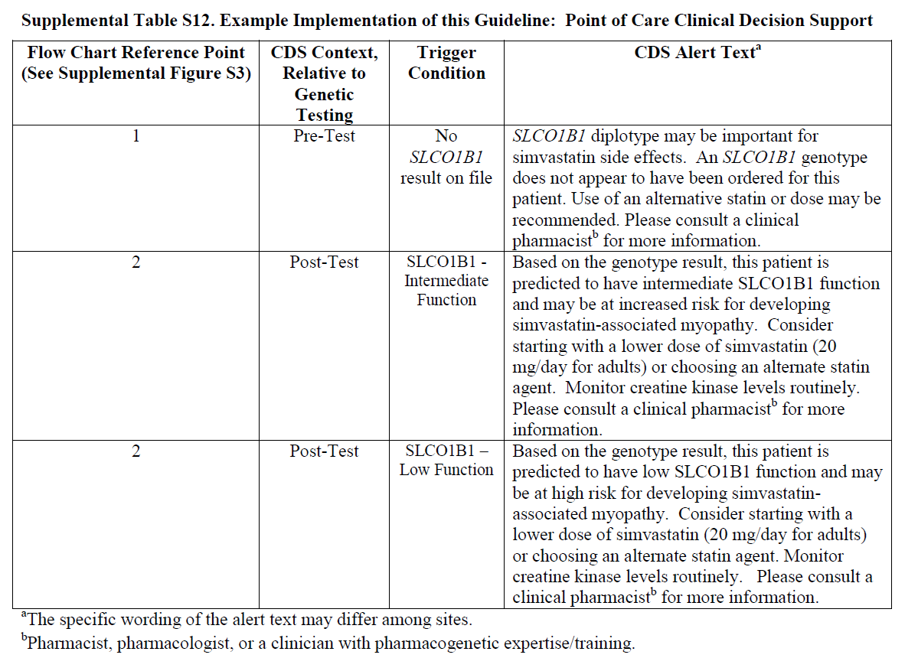

Slide 61
Summary
CPIC guidelines help clinicians understand HOW available genetic test results should be used to optimize drug therapy.
Not WHETHER tests should be ordered.
25 guidelines produced in a standard format
Published in Clinical Pharmacology and Therapeutics
Freely available on cpicpgx.org and
CPIC resources available to support the adoption of pharmacogenetics into the EHR with CDS

Slide 62
And:
CPIC informatics; Robert Freimouth, Ph.D
Andrea Gaedigk, Ph.D. (PharmVar)
Pgx Dissemination: Andrew Monte, M.D., Ph.D.; Daniel Mueller, M.D., Ph.D.; Andria Del Tredici, Ph.D.
Other CPIC staff and collaborators: Rose Gammal, Pharm.D.; Sarah Morris, Pharm.D.; Katrin Sangkuhl, Ph.D.; Li Gong, Ph.D.; Rachel Huddart, Ph.D.; Ryan Whaley
This work was funded by the National Institutes of Health (NIH) (R24GM115264 and U24HG010135)

