Slide 1
The Clinical Pharmacogenetics Implementation Consortium: Incorporating Pharmacogenetics into Clinical Practice and the EHR

Slide 2
Learning Objectives
After completing this activity, the learner should be able to:
Summarize barriers to clinical implementation of pharmacogenetics
Describe Clinical Pharmacogenetics Implementation Consortium (CPIC) and the underlying assumptions of CPIC guidelines
Explain the CPIC guideline development process
Illustrate how CPIC guidelines can be used by clinicians to make specific prescribing decisions for patient care when genetic information is available
Illustrate how CPIC guidelines can be used to aid the clinical implementation of pharmacogenomics into the electronic health record with clinical decision support

Slide 3
Survey: Challenges to Implementing Pharmacogenetics in the Clinic
What do you think is the most challenging aspect of the implementation of pharmacogenetics into the clinic?
Translation of genetic information into clinical action
Test cost, test reimbursement or other economic issues
Availability of high-quality genotyping test (CLIA approved)
Electronic medical record use, such as the application of CDS
Clinician and patient resistance and/or ethical concerns
Clin Pharmacol Ther. 2011 Mar;89(3):464-7.

Slide 4
Survey: Top 3 Challenges to Implementing Pharmacogenetics in the Clinic
95% of respondents selected: “process required to translate genetic information into clinical actions”
Next 2 responses:
Genotype test interpretation (e.g. using genotype information to impute phenotype)
Providing recommendations for selecting the drug/gene pairs to implement
Clin Pharmacol Ther. 2011 Mar;89(3):464-7.

Slide 5
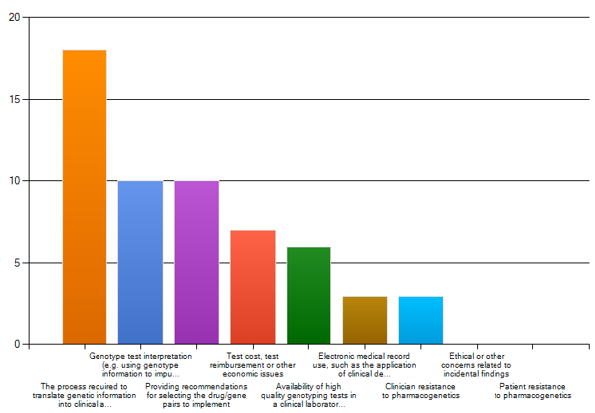
What Do You Think are 3 Most Challenging Aspects of Implementation of Pharmacogenomics into Clinic? (Please select 3)
Clin Pharmacol Ther. 2011 Mar;89(3):464-7.

Slide 6
Key Points about a CPIC Guideline
Based on assumption that the test results are in hand and NOT to discuss the merits of doing the test
Standardized formats
Systematic grading of evidence and recommendations
Peer-reviewed
Freely available
Updated regularly
Authorship with COI policy
Closely follow IOM practices
Published in Clinical Pharmacology and Therapeutics
COI=Conflict of Interest
IOM=Institute of Medicine

Slide 7
CPIC Guidelines Can Help Optimize Drug Therapy
CPIC guidelines are designed to help clinicians understand HOW available genetic test results should be used to optimize drug therapy
Not WHETHER tests should be ordered
Key Assumption:
Clinical high-throughput and pre-emptive genotyping will become more widespread
Clinicians will be faced with having patients’ genotypes available even if they did not order test with drug in mind

Slide 8
Published 28 guidelines and 17 updates, covering 34 genes and > 160 drugs as of February 2025
TPMT, NUDT15
Mercaptopurine, thioguanine, azathioprine
CYP2D6
Codeine, tramadol, hydrocodone, tricyclic antidepressants (TCAs), tamoxifen, selective serotonin reuptake inhibitors (SSRIs), ondansetron, tropisetron, atomoxetine, vortioxetine
Beta-blockers (CPIC level B or C)
Methadone, oxycodone (CPIC level C)
CYP2C19
TCAs, clopidogrel, voriconazole, SSRIs, proton pump inhibitors (PPIs), vortioxetine (CPIC level C)
VKORC1 and CYP4F2
Warfarin
CYP2C9
Warfarin, phenytoin, NSAIDs (nonsteroidal anti-inflammatory drugs), fluvastatin, aspirin (CPIC level C)
CYP2C8
NSAIDs
HLA-A
Carbamazepine
HLA-B
Allopurinol, carbamazepine, oxcarbazepine, abacavir, fosphenytoin, phenytoin
CFTR
Ivacaftor
DPYD
Fluorouracil, capecitabine, tegafur
G6PD
48 drugs
UGT1A1
Atazanavir
SLCO1B1
Statins
IFNL3 (IL28B)
Interferon
CYP3A5
Tacrolimus
CYP3A4/5
Statins (CPIC level C)
CYP2B6
Efavirenz, sertraline (CPIC level B)
Methadone (CPIC level C)
RYR1, CACNA1S
Inhaled anesthetics
mtRNR1
Aminoglycosides
ABCG2
Rosuvastatin
OPRM1 and COMT
Opioids (CPIC level C)
HMGCR
Statins (CPIC level C)
SLC6A4 and HTR2A
SSRIs, serotonin/norepinephrine reuptake inhibitors (SNRIs), vortioxetine, vilazodone (CPIC level C)
ADRB1, ADRB2, ADRA2C, GRK4, and GRK5
Beta-blockers (CPIC level C)
https://cpicpgx.org/guidelines/

Slide 9
CPIC by the Numbers
>750 members (clinicians and scientists)
28 guidelines (and counting!)
>520 institutions
34 genes
49 countries
>160 drugs
>50 CPIC informatics from >40 organizations
14 Observers (NIH, FDA, professional societies)
Updated August 2024
Notes:
89 in 2013
42 institutions

Slide 10
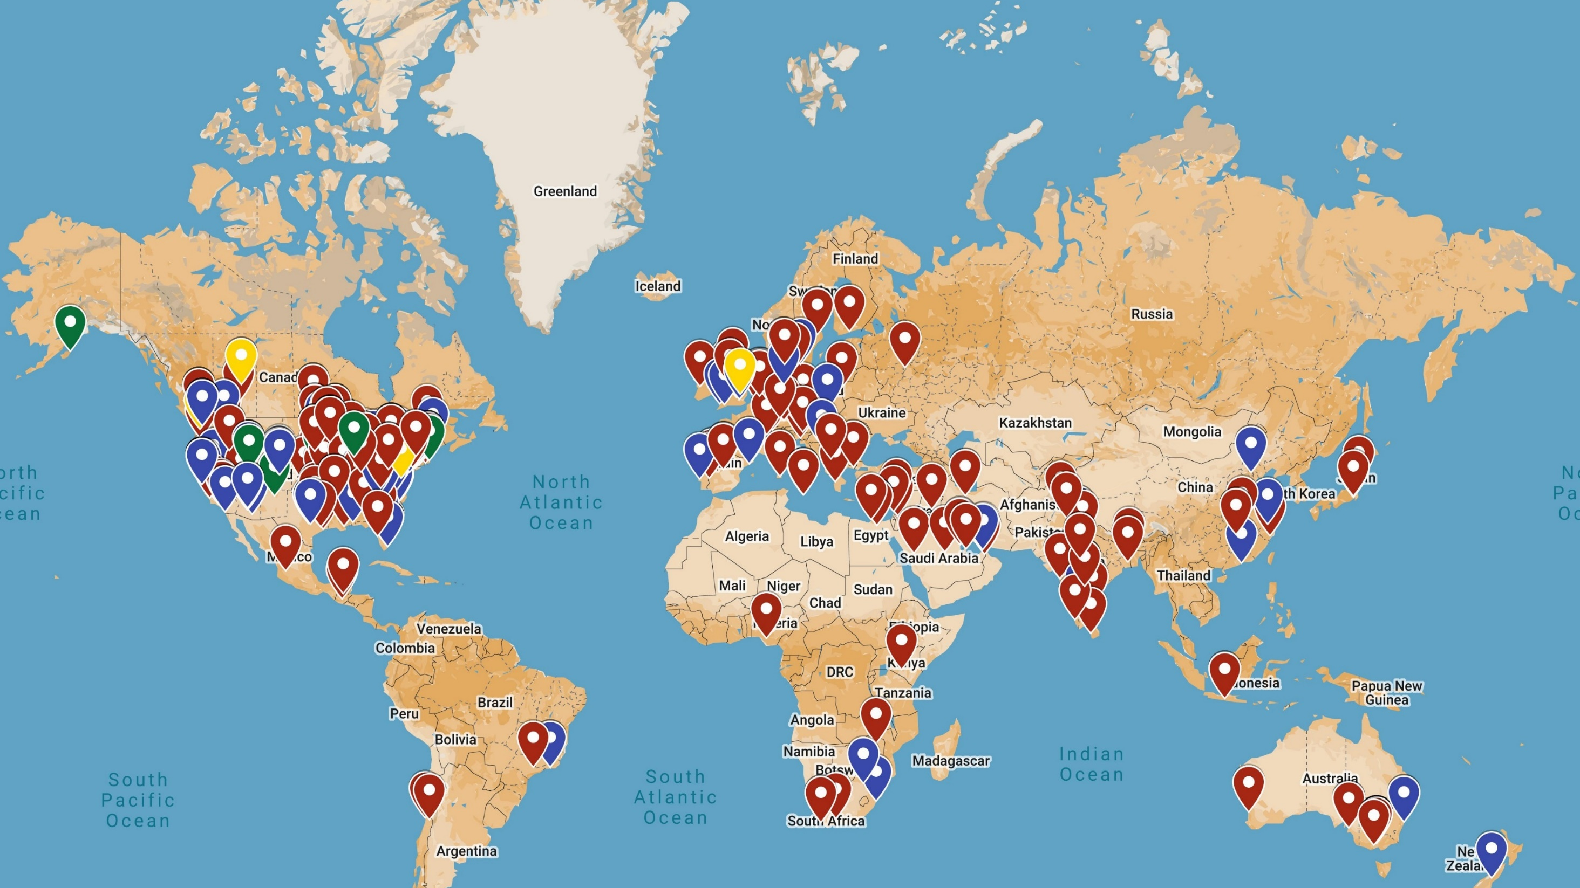
CPIC is a Global Organization

Slide 11
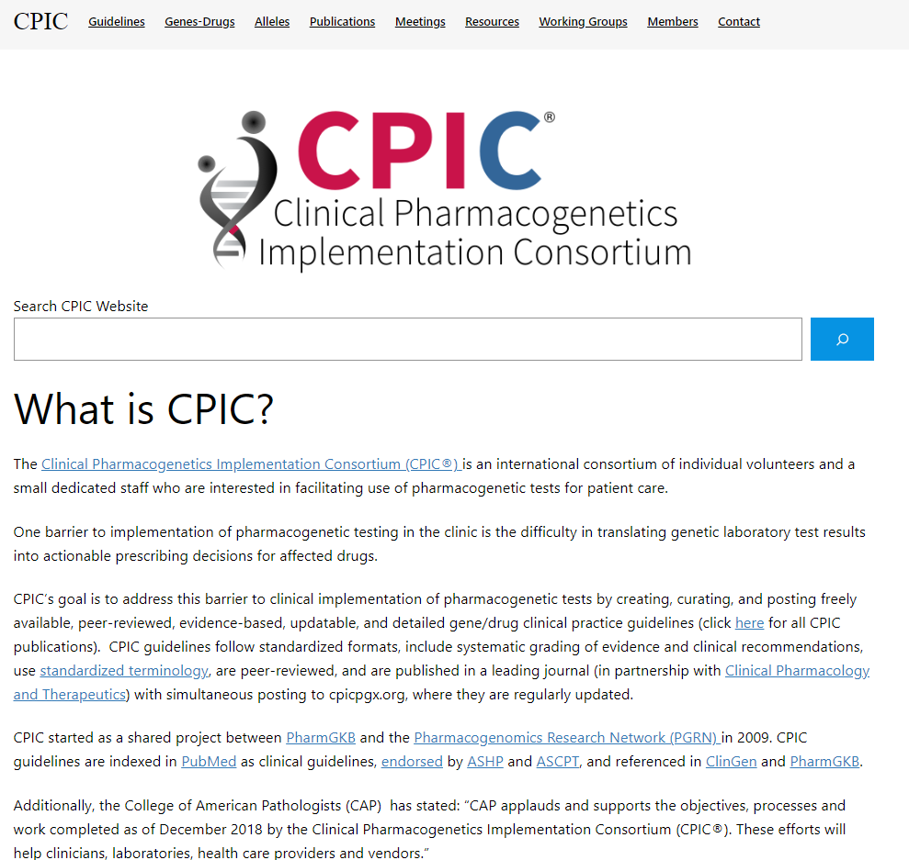
CPIC Website Highlights
Published guidelines
Genes-Drugs
Resources
Working groups
Membership
Contact information
www.cpicpgx.org

Slide 12
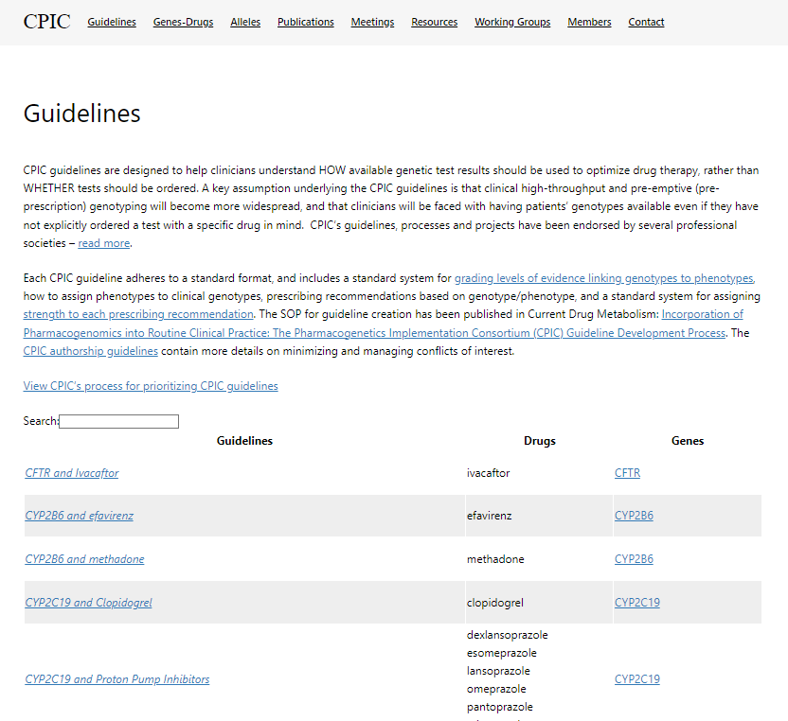
CPIC Guidelines
Links contain most recent guideline publication in addition to any updates, if applicable
Supplemental material
Additional resources applicable to the guideline
Links to guideline pages
https://cpicpgx.org/guidelines/

Slide 13
Information and Material Available within CPIC Guidelines
https://cpicpgx.org/guidelines/guideline-for-voriconazole-and-cyp2c19/

Slide 14
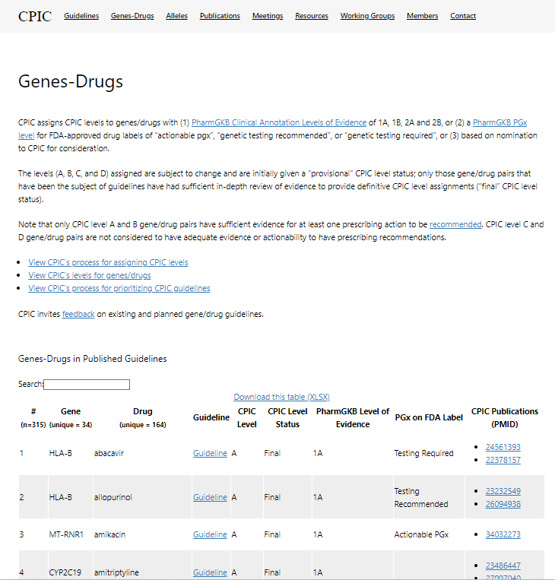
Genes-Drugs Tab
Organized by gene with corresponding drug
Defines CPIC level status
Quick links to guideline as well as publications (PMID)
https://cpicpgx.org/genes-drugs/

Slide 15
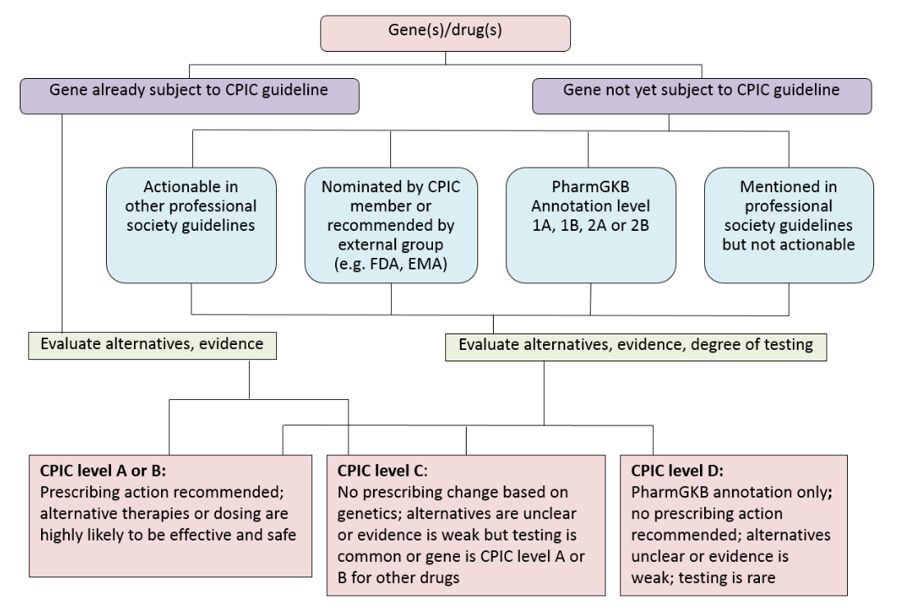
Considerations for Assignment of CPIC Level for Genes/Drugs
https://cpicpgx.org/prioritization/#flowchart

Slide 16
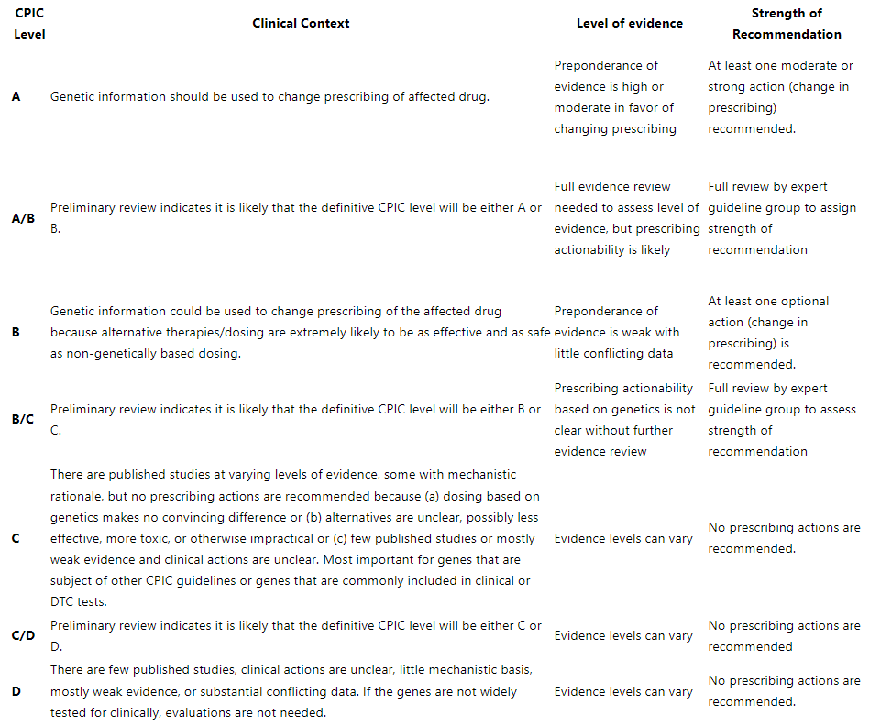
Level Definitions for CPIC Genes/Drugs
https://cpicpgx.org/prioritization/#flowchart

Slide 17
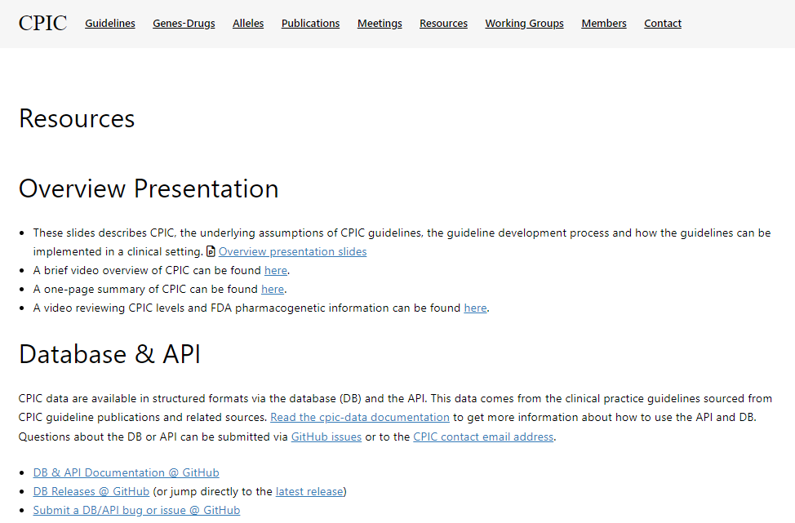
Resources Available on CPIC Website
CPIC Overview slides
https://cpicpgx.org/resources/

Slide 18
Resources Available on CPIC Website, cont.
Institutions utilizing CPIC guidelines with contact information, if available
CPIC projects
CPIC SOPs
https://cpicpgx.org/resources/

Slide 19
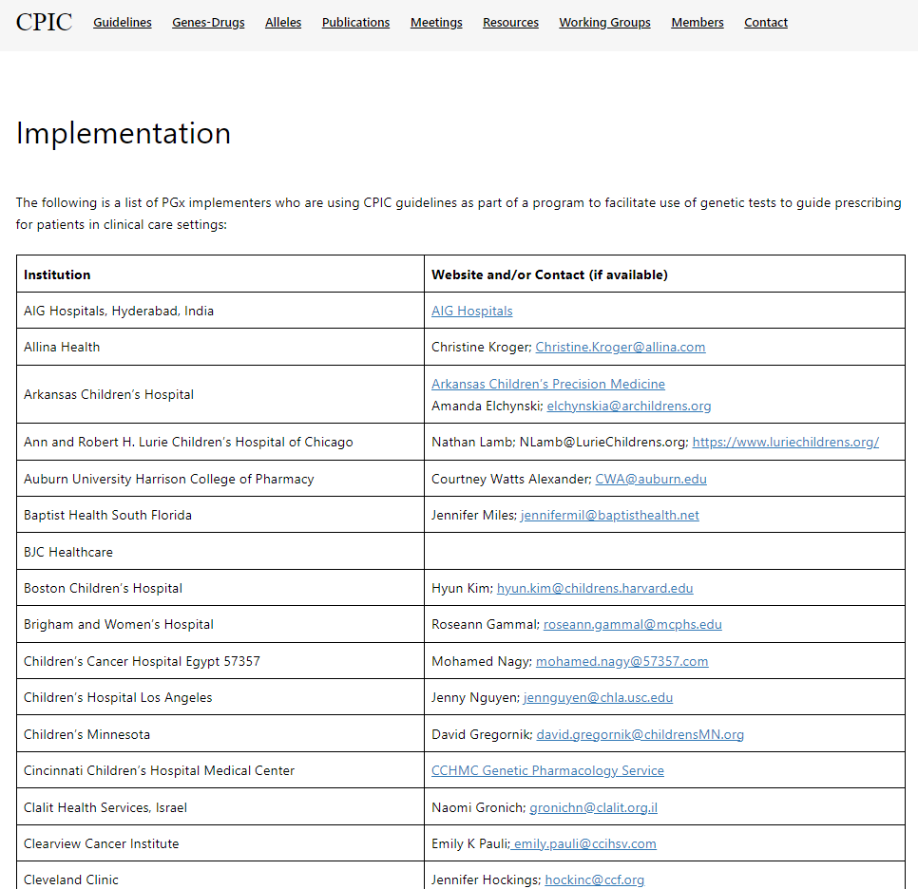
Sites Utilizing CPIC Guidelines
CPIC maintains a list of self-identified PGx implementers who use the CPIC guidelines, including over 128 academic and/or healthcare institutions (27 outside the USA) and 40 commercial laboratories and other companies (educational resources, translational software companies).
https://cpicpgx.org/implementation/

Slide 20
How Can CPIC Accelerate the Clinical Implementation of Pharmacogenetics into EHRs with CDS?
CDS=Clinical decision support
EHR=Electronic health record
https://cpicpgx.org/informatics/

Slide 21
CPIC Informatics Working Group
Goal is to support adoption of the CPIC guidelines by identifying, and resolving where possible, potential technical barriers to the implementation of the guidelines within a clinical electronic environment
Forum for discussion and collaboration focused on informatics issues
Growing interest in informatics aspects of CPIC guidelines and clinical implementation of pharmacogenetics
https://cpicpgx.org/informatics/

Slide 22
CPIC Informatics Working Group: Initial Focus
Create comprehensive translation tables from genotype to phenotype to clinical recommendation for CPIC guidelines
Define structure and process to efficiently develop and maintain in the most useful format(s)
Publish as part of CPIC guidelines and post on PharmGKB
Genotype/Diplotype
Phenotype
Recommendation
https://cpicpgx.org/informatics/

Slide 23
CDS Workflow, Alerts and Flow Chart Resources within CPIC Guidelines
https://cpicpgx.org/guidelines/guideline-for-voriconazole-and-cyp2c19/

Slide 24
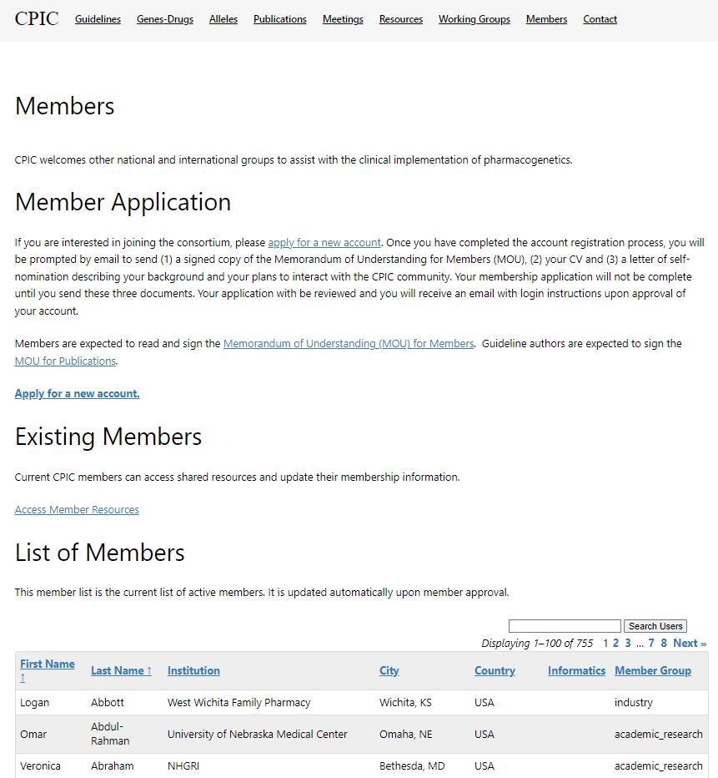
Membership Details
Membership application link available to apply for new membership
Existing members have access to member resources
Provides names, institution, group etc. of each existing member (list only available to CPIC members)
https://cpicpgx.org/members/

Slide 25
How to Get in Contact with CPIC or be Contacted by CPIC?
https://cpicpgx.org/contact/

Slide 26
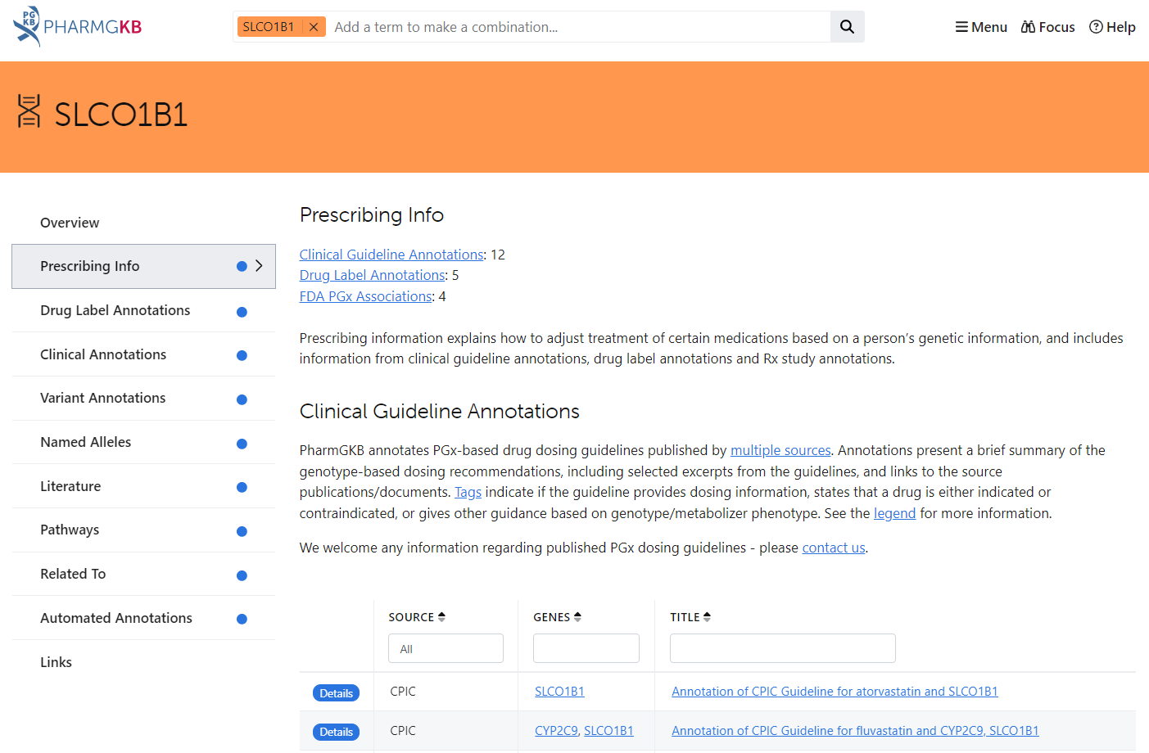
CPIC guidelines are posted on PharmGKB
https://www.pharmgkb.org/

Slide 27
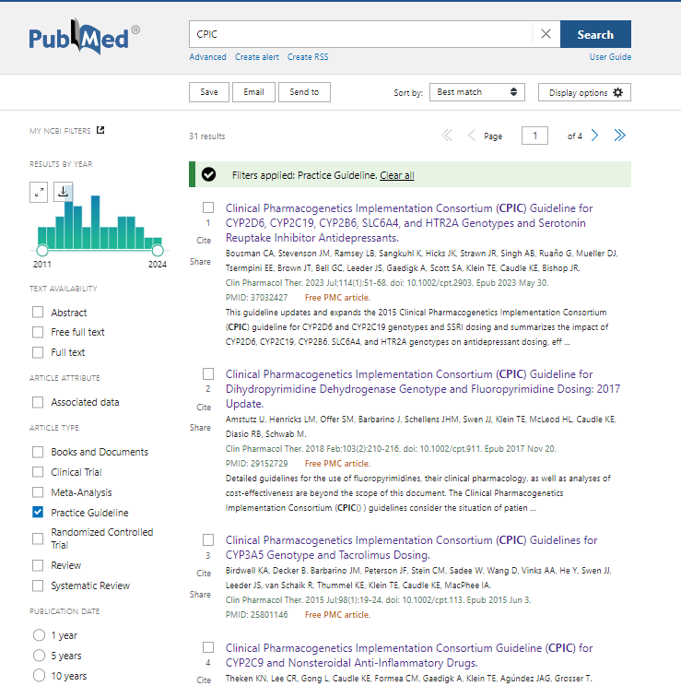
CPIC Guidelines Linked to “Practice Guideline” Filter on PubMed

Slide 28
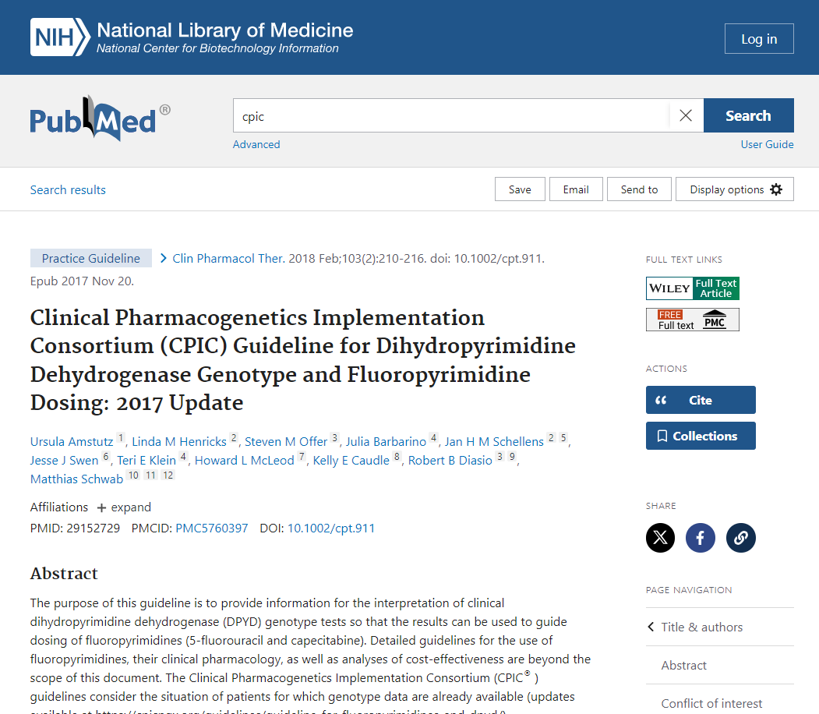
All CPIC Guidelines are Available for Free thru PMC

Slide 29
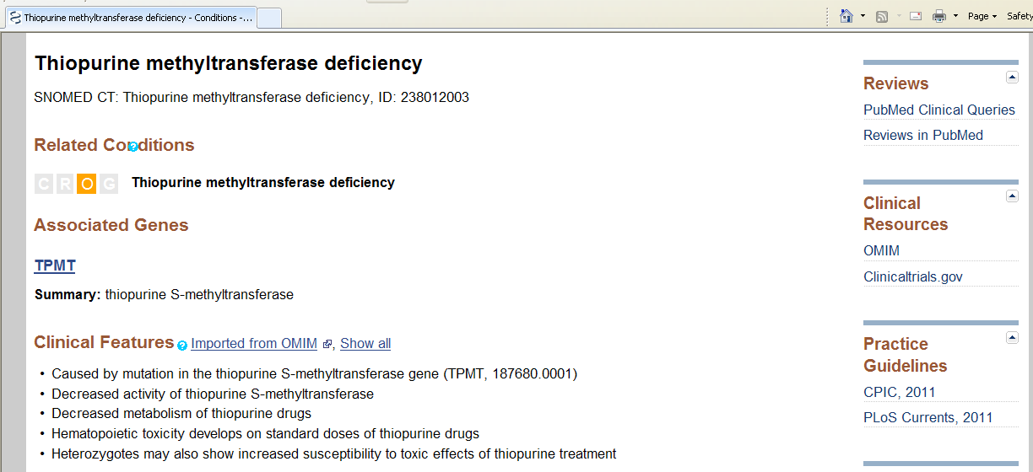
CPIC is cited in NIH’s Genetic Test Registry (GTR) for clinical pharmacogenetic tests

Slide 30
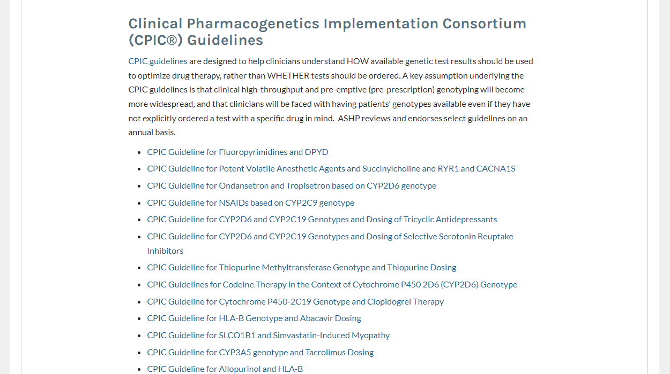
ASHP and ASCPT Endorse CPIC Guidelines
ASHP Endorsed Documents
ASCPT Tools and Resources

Slide 31
CPIC Guidelines Cited in Clinical Practice Guidelines
NCCN Clinical Practice Guidelines in Oncology (NCCN Guidelines®) for Guideline Pediatric Acute Lymphoblastic Leukemia 06.2024. © National Comprehensive Cancer Network, Inc. 2024. All rights reserved. Accessed August 23, 2024.

Slide 32
ClinGen Partnership

Slide 33
Learn More about the CPIC Guideline Development Process
Purpose:
To describe the development process of the CPIC guidelines
To compare our process to the Institute of Medicine’s Standards for Developing Trustworthy Clinical Practice Guidelines
Curr Drug Metab. 2014 Feb;15(2):209-17.

Slide 34
CPIC Aligns with IOM Standards for Clinical Practice Guideline Development
Curr Drug Metab. 2014 Feb;15(2):209-17.

Slide 35
CPIC Standardized Terminology for Allele Function and Phenotype
Genet Med. 2017 Feb;19(2): 215-23.

Slide 36
Uniform Elements of CPIC Guidelines: Main
Introduction
Focused literature review
Gene(s)
Background
Genetic test interpretation
Table 1-Assignment of likely [gene] phenotypes based on genotypes
Available genetic test options
Incidental findings
Other considerations
Curr Drug Metab. 2014 Feb;15(2):209-17.

Slide 37
Uniform Elements of CPIC Guidelines: Main, cont.
Drug(s)
Background
Linking genetic variability to variability in drug-related phenotypes
Dosage recommendations/Therapeutic recommendations
Table 2-Recommended Prescribing of [drug/s] by [gene] phenotype
Strength of recommendations grading system
Recommendations for incidental findings
Other considerations
Potential benefits and risks for the patient
Caveats: appropriate use and/or potential misuse of genetic tests
Curr Drug Metab. 2014 Feb;15(2):209-17.

Slide 38
Uniform Elements of CPIC Guideline: Supplement and Online Resources
Literature review details
Genetic test interpretation
Available genetic test options
Supplemental tables
Evidence linking genotype with phenotype
Levels of evidence grading system
Allele definition table
Allele functionality table
Frequency table
Resources to facilitate incorporation of pharmacogenetics into an electronic health record with clinical decision support (CDS)
Workflow diagrams
CDS alerts and consult examples

Slide 39
Breaking Down the Guideline: Tables 1 & 2
Clin Pharmacol Ther. 2017 Jul;102(1):182-9.

Slide 40
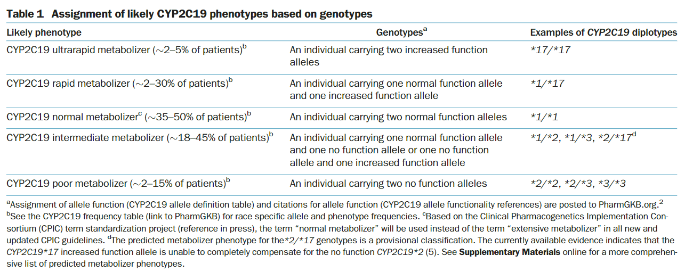
Table 1-Phenotype Based on Genotype for CYP2C19 and Voriconazole
Clin Pharmacol Ther. 2017 Jul;102(1):182-9.

Slide 41
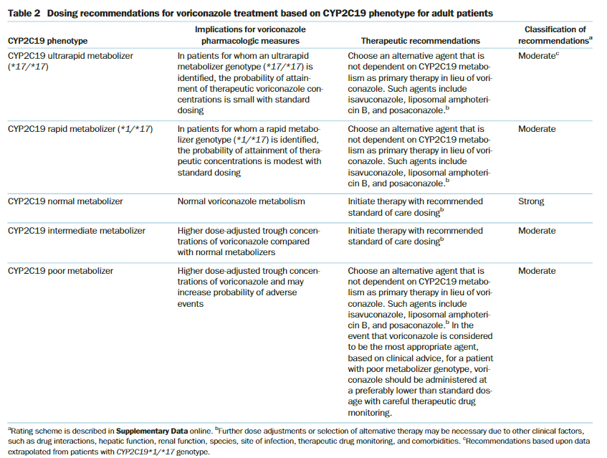
Table 2-Prescribing Recommendations of Voriconazole by CYP2C19 Phenotype
Clin Pharmacol Ther. 2017 Jul;102(1):182-9.

Slide 42
https://cpicpgx.org/strength-of-recommendations/

Slide 43
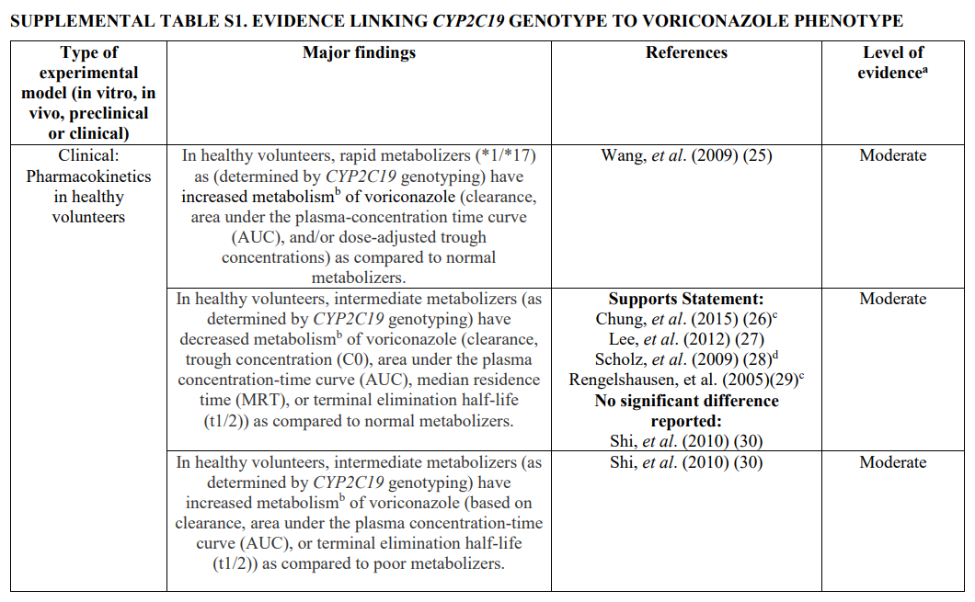
Level of Evidence Definitions
High: Evidence includes consistent results from well-designed, well-conducted studies.
Moderate: Evidence is sufficient to determine effects, but the strength of the evidence is limited by the number, quality, or consistency of the individual studies; generalizability to routine practice; or indirect nature of the evidence.
Weak: Evidence is insufficient to assess the effects on health outcomes because of limited number or power of studies, important flaws in their design or conduct, gaps in the chain of evidence, or lack of information.
https://files.cpicpgx.org/data/guideline/publication/voriconazole/2016/27981572-supplement.pdf

Slide 44
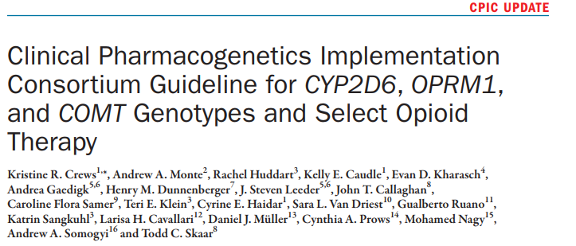
Breaking Down the Guideline: Tables 1 & 2, again
Clin Pharmacol Ther. 2021 Oct;110(4):888-96.

Slide 45
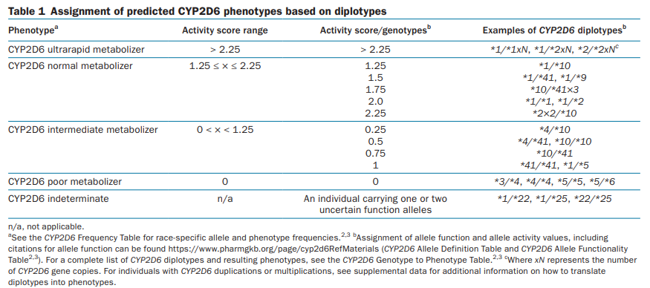
Table 1-Phenotype Based on Genotype for CYP2D6 and Opioids
Clin Pharmacol Ther. 2021 Oct;110(4):888-96.

Slide 46
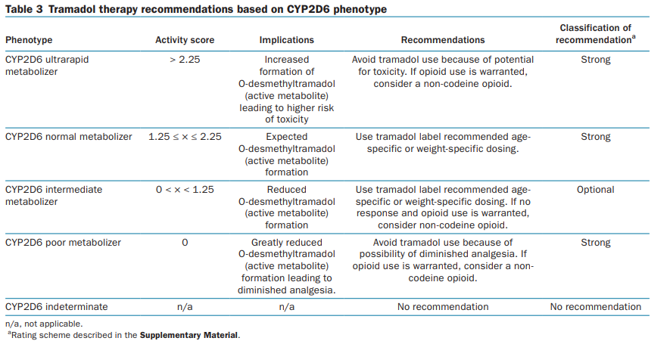
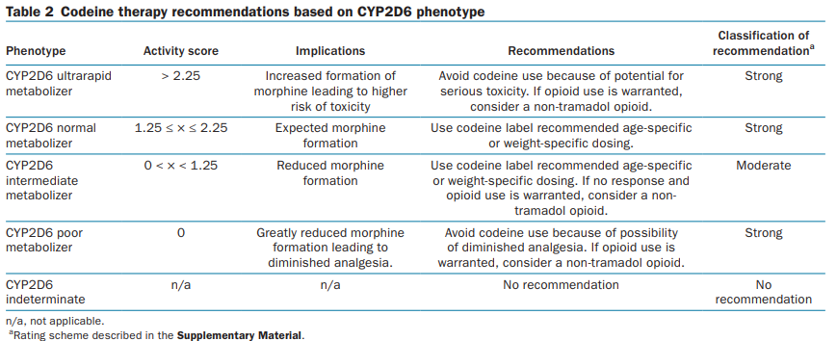
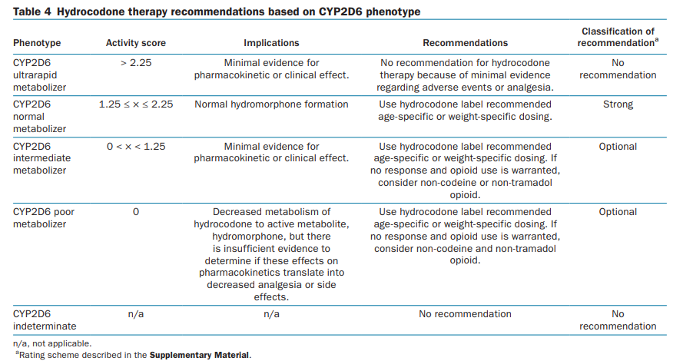
Table 2-Prescribing Recommendations of Opioids by CYP2D6 Phenotype
Clin Pharmacol Ther. 2021 Oct;110(4):888-96.

Slide 47
CPIC Tables Allow Translation of Genetic Test Results to Actionability
Allele Definition Table
Genotypes to alleles
(e.g. g.94775367A>G= CYP2C19*2)
Alleles to diplotypes
(e.g. g.94775367AG+ g.94780653GA= CYP2C19*2/*3)
Diplotype Phenotype Table
Diplotypes to phenotypes
(e.g. CYP2C19*2/*3 = poor metabolizer)
Phenotypes to actionability
(e.g. poor metabolizer + Rx for clopidogrel = interruptive alert)
Allele Functionality Table
Functions to alleles
(e.g. CYP2C19*2 = no function)
Interpretation of phenotypes
(e.g. CYP2C19 poor metabolizer = avoid clopidogrel, if possible, due to risk of therapeutic failure)
https://cpicpgx.org/guidelines/
https://www.pharmgkb.org/page/cyp2c19RefMaterials

Slide 48
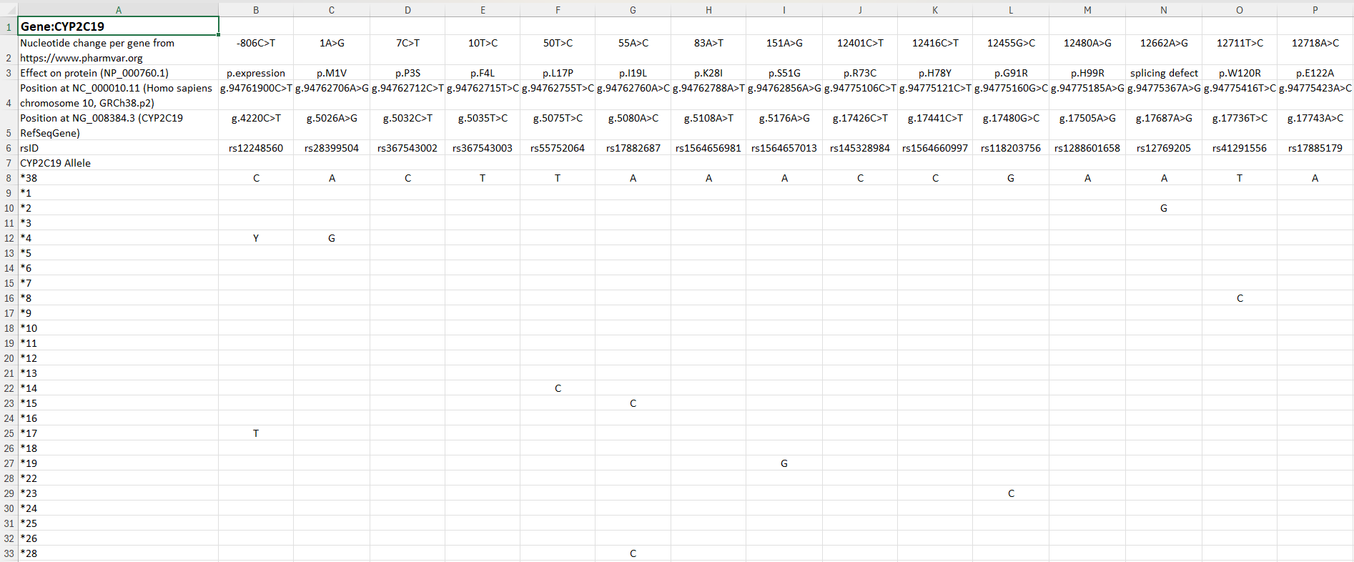
Allele Definition Table: Genotypes to Alleles (now maintained by PharmVar)
https://www.pharmgkb.org/page/pgxGeneRef
https://cpicpgx.org/guidelines/guideline-for-clopidogrel-and-cyp2c19/
https://www.pharmvar.org/

Slide 49
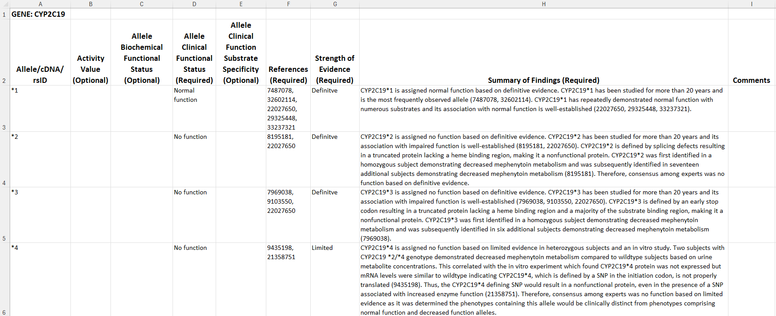
Allele Functionality Table: Alleles to Function
https://cpicpgx.org/guidelines/guideline-for-clopidogrel-and-cyp2c19/

Slide 50
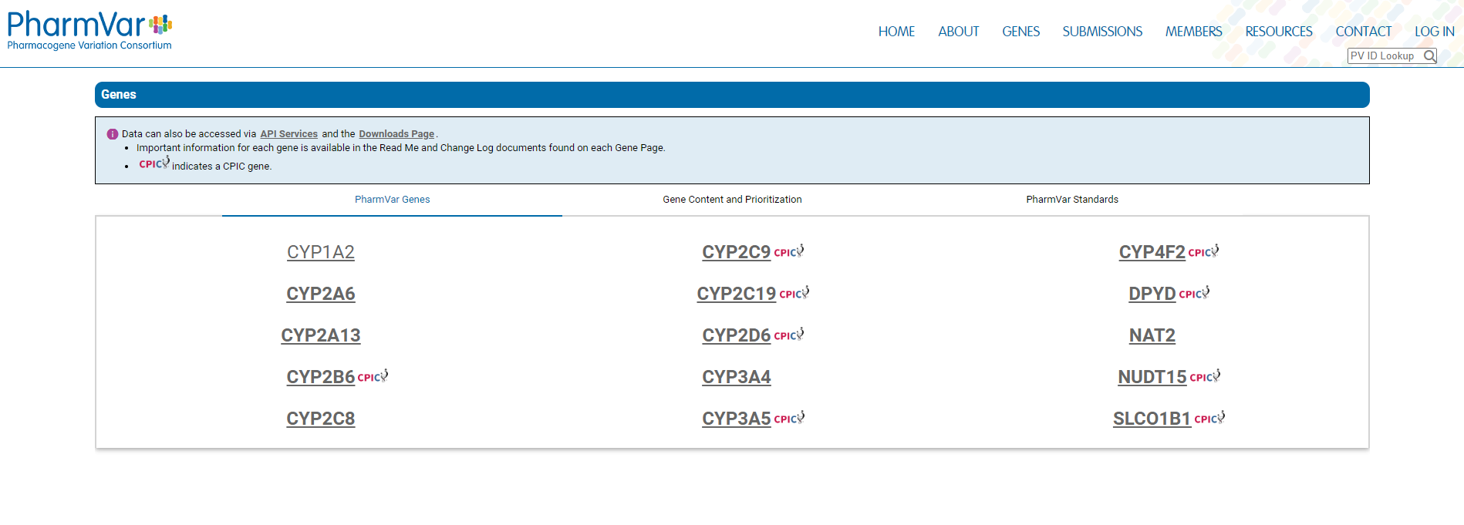
Central Repository for pharmacogene variation
Focuses on haplotype structure and allelic variation
https://www.pharmvar.org/genes

Slide 51
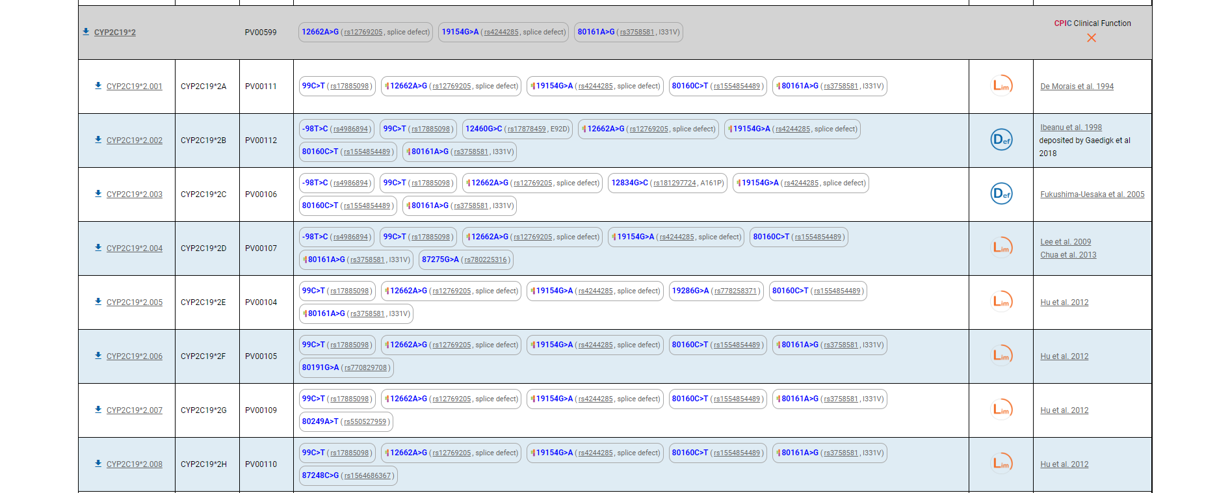
CYP2C19 Gene within PharmVar
https://www.pharmvar.org/gene/CYP2C19

Slide 52
CPIC Tables Allow Translation of Genetic Test Results to Actionability, cont.
Allele Definition Table
Genotypes to alleles
(e.g. g.94775367A>G= CYP2C19*2)
Alleles to diplotypes
(e.g. g.94775367AG+ g.94780653GA= CYP2C19*2/*3)
Diplotype Phenotype Table
Diplotypes to phenotypes
(e.g. CYP2C19*2/*3 = poor metabolizer)
Phenotypes to actionability
(e.g. poor metabolizer + Rx for clopidogrel = interruptive alert)
Allele Functionality Table
Functions to alleles
(e.g. CYP2C19*2 = no function)
Interpretation of phenotypes
(e.g. CYP2C19 poor metabolizer = avoid clopidogrel, if possible, due to risk of therapeutic failure)
https://cpicpgx.org/guidelines/
https://www.pharmgkb.org/page/cyp2c19RefMaterials

Slide 53
Variants Must be Phased to Assign Diplotypes for Pharmacogenes
CPIC Gene | Var/var different than var/wt?
TPMT | Yes
CYP2C19 | Yes
CYP2D6 | Yes
DPYD | Yes
CYP2C9 | Yes
SLCO1B1 | Yes
HLA-B | No
VKORC1 | Yes
IL28-B | Yes
CFTR | No
G6PD | Yes
UGT1A1 | Yes
CYP3A5 | Yes

Slide 54
CPIC Tables Allow Translation of Genetic Test Results to Actionability, cont.
Allele Definition Table
Genotypes to alleles
(e.g. g.94775367A>G= CYP2C19*2)
Alleles to diplotypes
(e.g. g.94775367AG+ g.94780653GA= CYP2C19*2/*3)
Diplotype Phenotype Table
Diplotypes to phenotypes
(e.g. CYP2C19*2/*3 = poor metabolizer)
Phenotypes to actionability
(e.g. poor metabolizer + Rx for clopidogrel = interruptive alert)
Allele Functionality Table
Functions to alleles
(e.g. CYP2C19*2 = no function)
Interpretation of phenotypes
(e.g. CYP2C19 poor metabolizer = avoid clopidogrel, if possible, due to risk of therapeutic failure)
https://cpicpgx.org/guidelines/
https://www.pharmgkb.org/page/cyp2c19RefMaterials

Slide 55
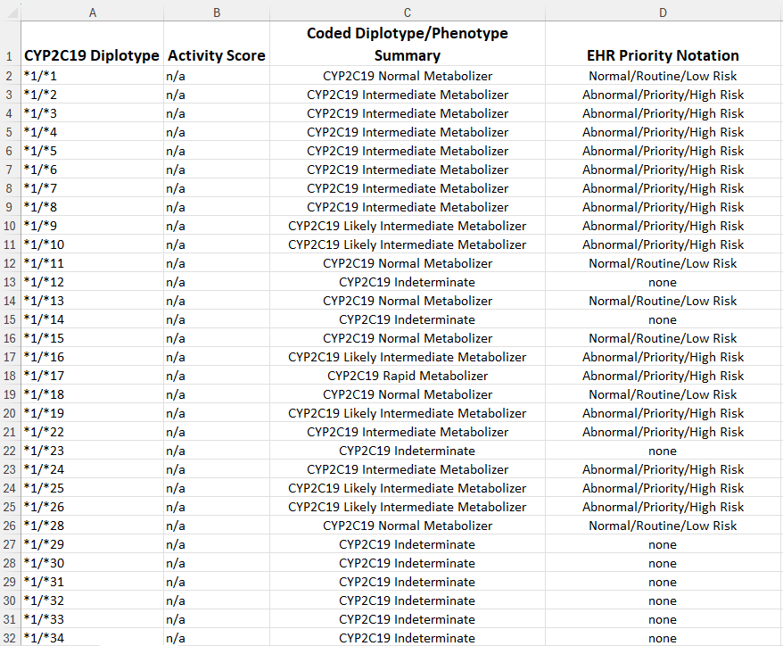
Diplotype to Phenotype Table
https://www.pharmgkb.org/page/cyp2c19RefMaterials
https://cpicpgx.org/guidelines/guideline-for-clopidogrel-and-cyp2c19/

Slide 56
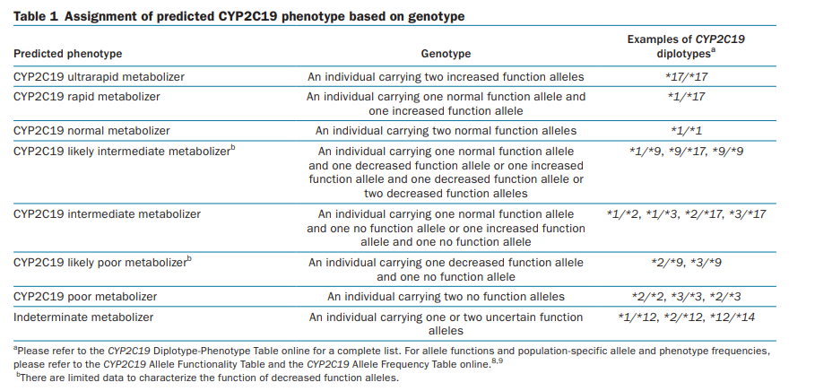
Interpretation of Phenotypes: Genotype to Phenotype Assignment Based on Allele Function
Clin Pharmacol Ther. 2022 Nov;112(5):959-67.
https://cpicpgx.org/guidelines/guideline-for-clopidogrel-and-cyp2c19/

Slide 57
CPIC Utilizes Standardized Genotype to Phenotype Translations

Slide 58
CPIC Tables Allow Translation of Genetic Test Results to Actionability, cont.
Allele Definition Table
Genotypes to alleles
(e.g. g.94775367A>G= CYP2C19*2)
Alleles to diplotypes
(e.g. g.94775367AG+ g.94780653GA= CYP2C19*2/*3)
Diplotype Phenotype Table
Diplotypes to phenotypes
(e.g. CYP2C19*2/*3 = poor metabolizer)
Phenotypes to actionability
(e.g. poor metabolizer + Rx for clopidogrel = interruptive alert)
Allele Functionality Table
Functions to alleles
(e.g. CYP2C19*2 = no function)
Interpretation of phenotypes
(e.g. CYP2C19 poor metabolizer = avoid clopidogrel, if possible, due to risk of therapeutic failure)
https://cpicpgx.org/guidelines/
https://www.pharmgkb.org/page/cyp2c19RefMaterials

Slide 59
Pharmacogenetic Test Result: Clinical Implementation Workflow for EHR
https://files.cpicpgx.org/images/Gene-Agnostic_Implementation_Workflow.svg

Slide 60
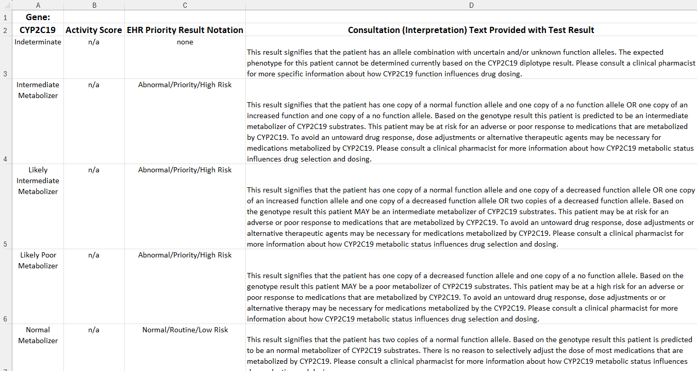
Pharmacogenetic Test Result: EHR Consult
https://cpicpgx.org/guidelines/guideline-for-clopidogrel-and-cyp2c19/

Slide 61
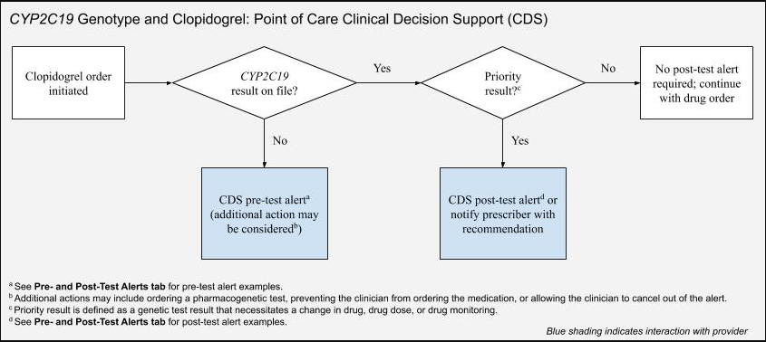
Genotypes and Clopidogrel: Point of Care Clinical Decision Support (CDS)
1
2
https://files.cpicpgx.org/images/flow_chart/Clopidogrel_CDS_Flow_Chart.jpg

Slide 62
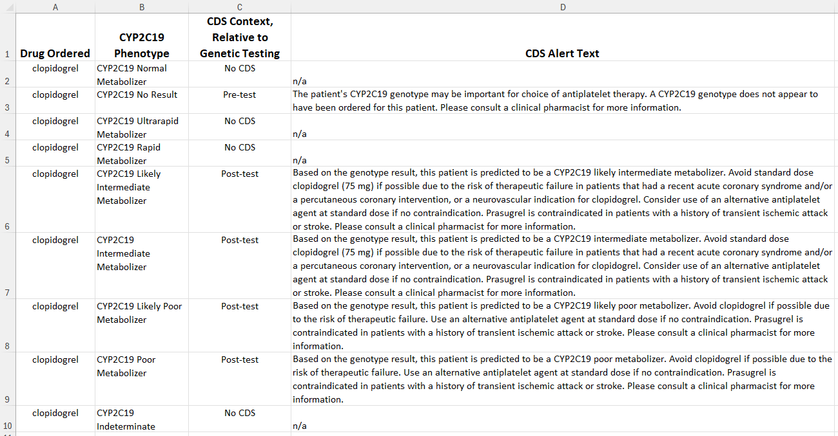
Pharmacogenetic Test Result: Pre and Post-Test Alerts
https://cpicpgx.org/guidelines/guideline-for-clopidogrel-and-cyp2c19/

Slide 63
CPIC Guidelines Updates
Evaluated on an ongoing basis and updated regularly
Update to publications:
New publication with re-publishing main dosing tables
Changes as needed to supplemental material and website
Update to cpicpgx.org: as needed, without waiting for updated publication

Slide 64
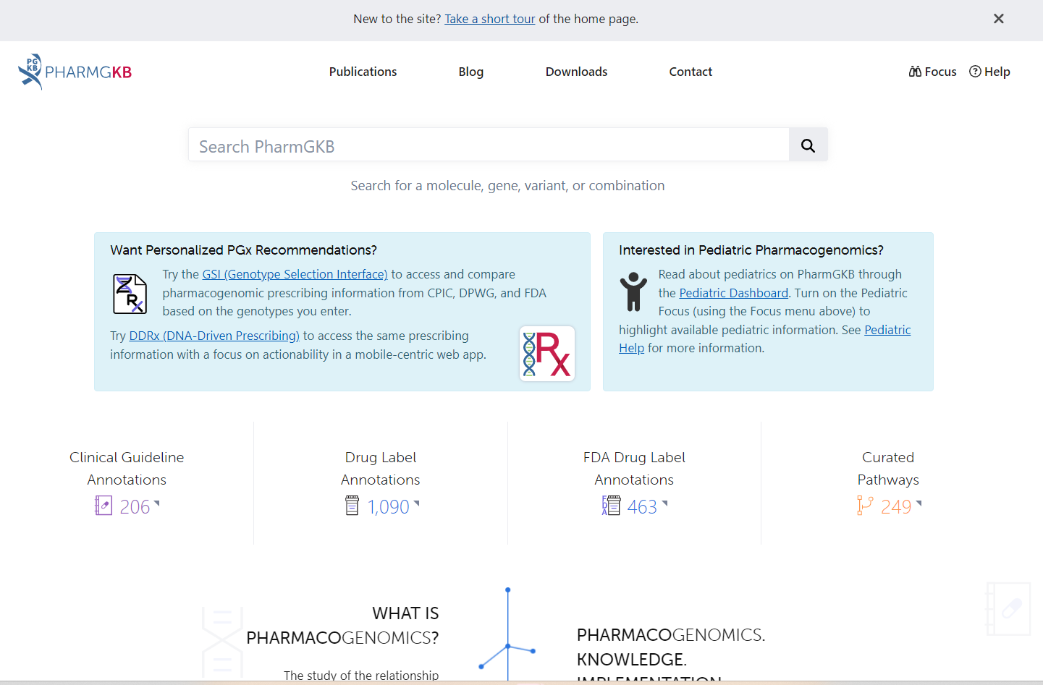
PharmGKB Genotype Selection Interface (GSI)
Link to GSI Tool
https://www.pharmgkb.org/

Slide 65
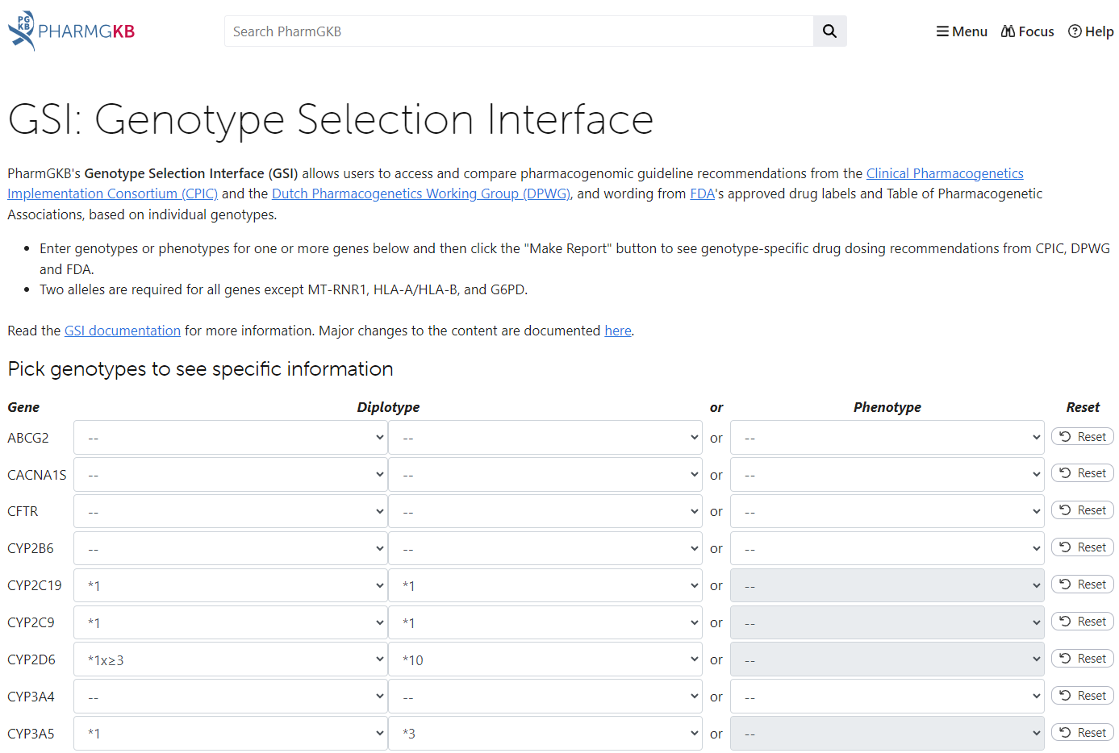
PharmGKB GSI Tool
Allows you to enter diplotype or phenotype data based on genes
https://www.pharmgkb.org/genotype

Slide 66
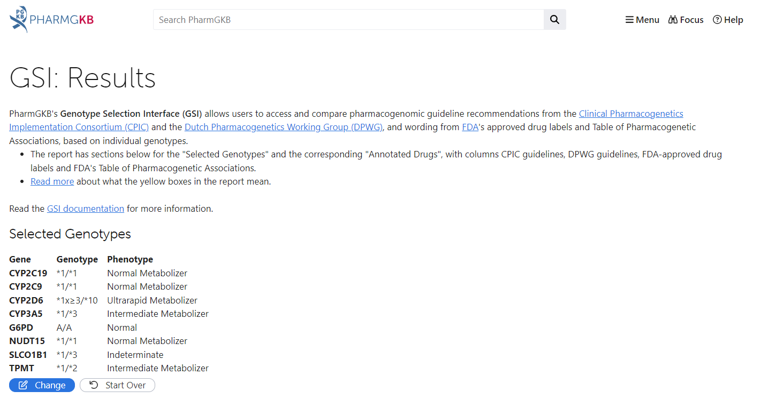
PharmGKB GSI Results
https://www.pharmgkb.org/genotype

Slide 67
PharmGKB GSI Results, cont.
https://www.pharmgkb.org/genotype

Slide 68
PharmGKB GSI Results, cont.
https://www.pharmgkb.org/genotype

Slide 69
Summary
CPIC guidelines help clinicians understand HOW available genetic test results should be used to optimize drug therapy.
Not WHETHER tests should be ordered.
>25 guidelines produced in a standard format
Published in Clinical Pharmacology and Therapeutics
Freely available on cpicpgx.org and PharmGKB
CPIC resources available to support the adoption of pharmacogenetics into the EHR with CDS

Slide 70
TEAM
CPIC Co-Principle Investigators
Kelly E. Caudle, Pharm.D., Ph.D.
St. Jude Children’s Research Hospital
Teri E. Klein, Ph.D.
Stanford University
Co-Investigator
Michelle Whirl-Carrillo, Ph.D.
Stanford University
Mary V. Relling, Pharm.D.
St. Jude Children’s Research Hospital
James M. Hoffman, Pharm.D.
St. Jude Children’s Research Hospital
CPIC Informatics Co-Directors
Michelle Whirl-Carrillo, Ph.D.
Stanford University
James M. Hoffman, Pharm.D.
St. Jude Children’s Research Hospital
Stanford CPIC Coordinator
Michelle Whirl-Carrillo, Ph.D.
Stanford University
STEERING COMMITTEE
Teri E. Klein, Ph.D.
Stanford University
Kelly E. Caudle, Pharm.D., Ph.D.
St. Jude Children’s Research Hospital
Michelle Whirl-Carrillo, Ph.D.
Stanford University
Mary V. Relling, Pharm.D.
St. Jude Children’s Research Hospital
Dan M. Roden, M.D.
Vanderbilt University
Rachel F. Tyndale, Ph.D.
University of Toronto and CAMH
Larisa Cavallari, Pharm.D.
University of Florida
Stuart A Scott, Ph.D.
Stanford University and Stanford Healthcare
Sara Van Driest, M.D., Ph.D.
Vanderbilt University
St. Jude Children’s Research Hospital Team
Melissa Bourque, Pharm.D.
Melissa Cordeiro, MS MCB
Kristine Crews, Pharm.D.
Rose Donnelly, Pharm.D.
Cyrine Haidar, Pharm.D.
James Hoffman, Pharm.D.
Bailey Tibben, Ph.D.
Other CPIC Staff and Collaborators:
Katrin Sangkuhl, Ph.D.
Li Gong, Ph.D.
Ryan Whaley
Andrea Gaedigk, Ph.D.-PharmVAR
A big thank you to all CPIC Members and CPIC Guideline Authors
This work was funded by the National Institutes of Health (NIH) (R24GM115264 and U24HG010135)

